Slide 1
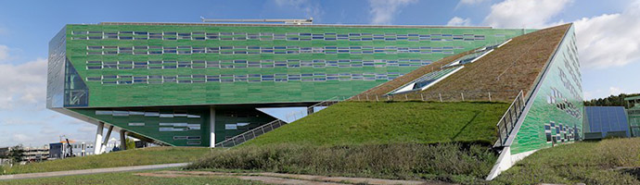

Flexibel door het leven door je aan de tijd te houden
Hans van Veen
Evolutionary Plant-Ecophysiology
Groningen Institute of Evolutionary Life Sciences
University of Groningen, the Netherlands

Slide 2
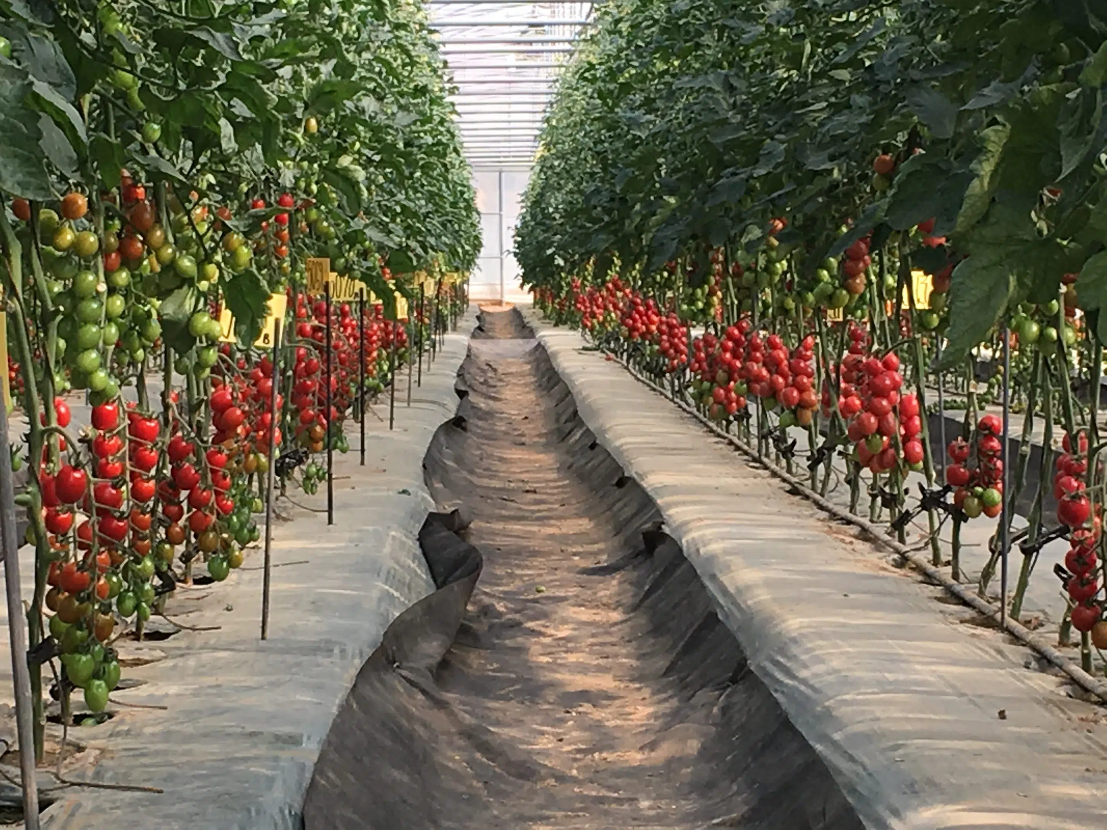
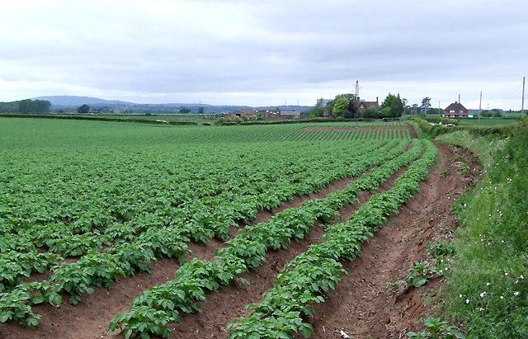
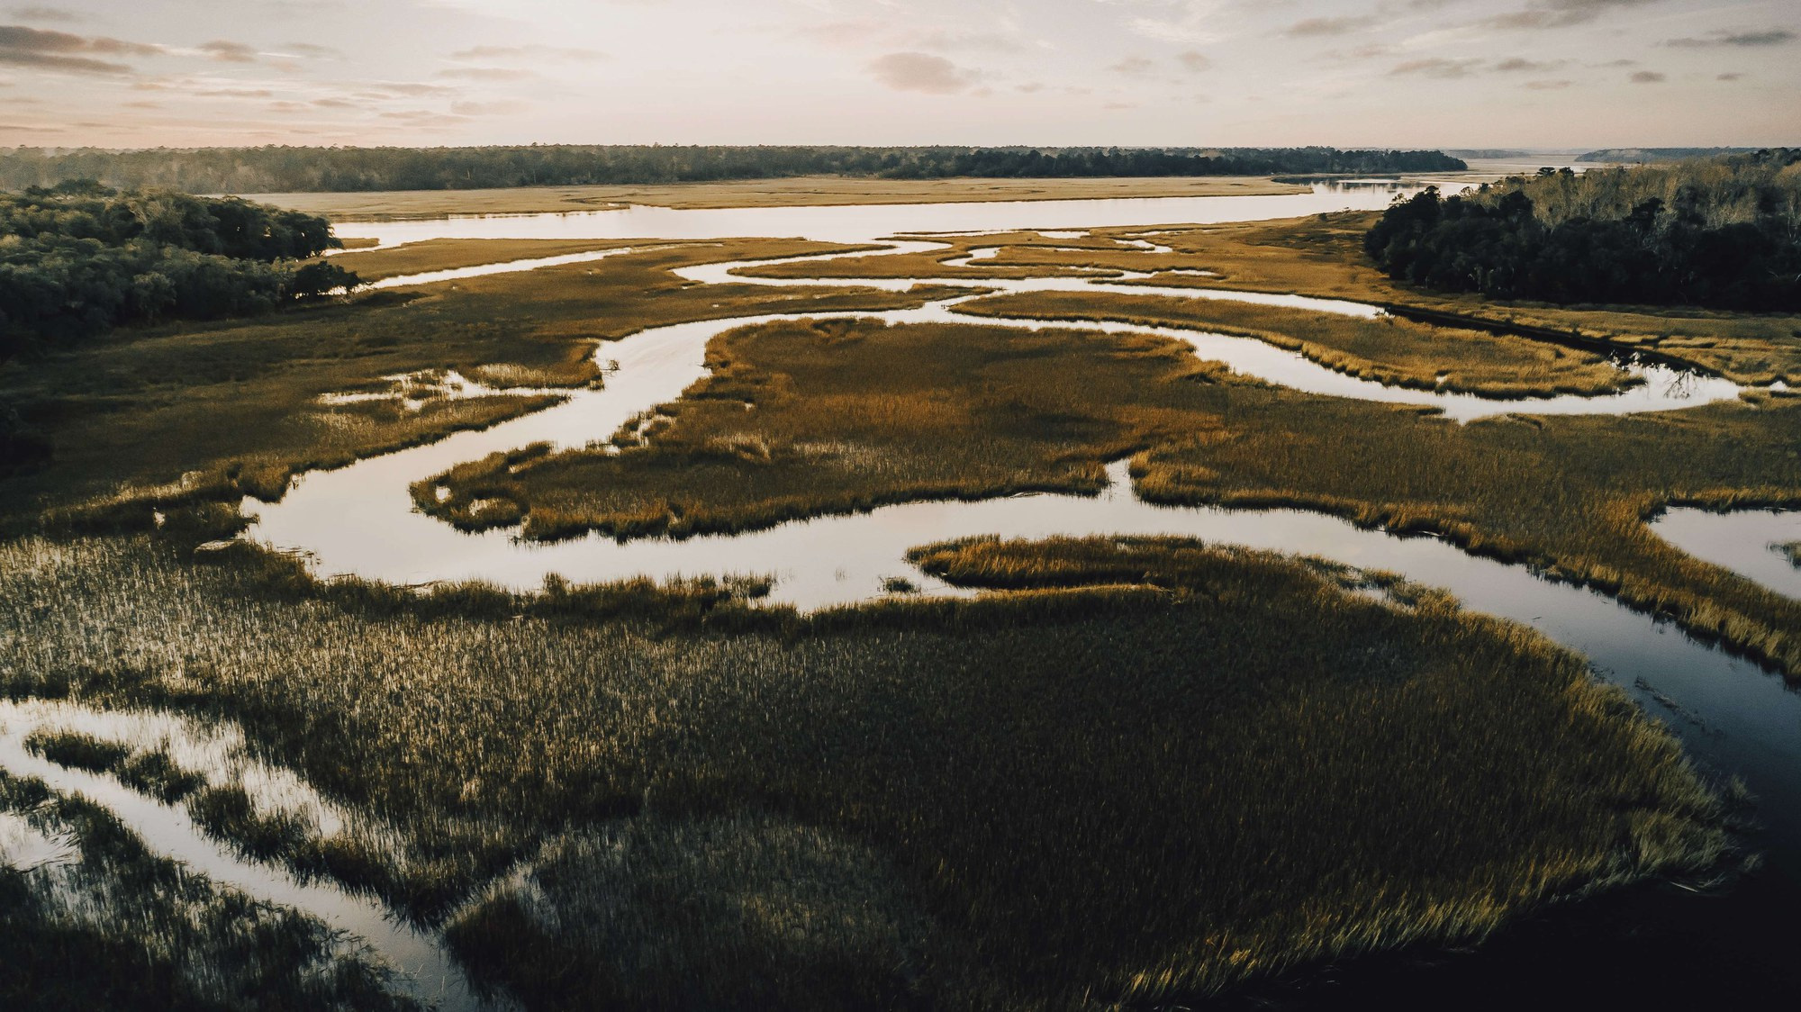
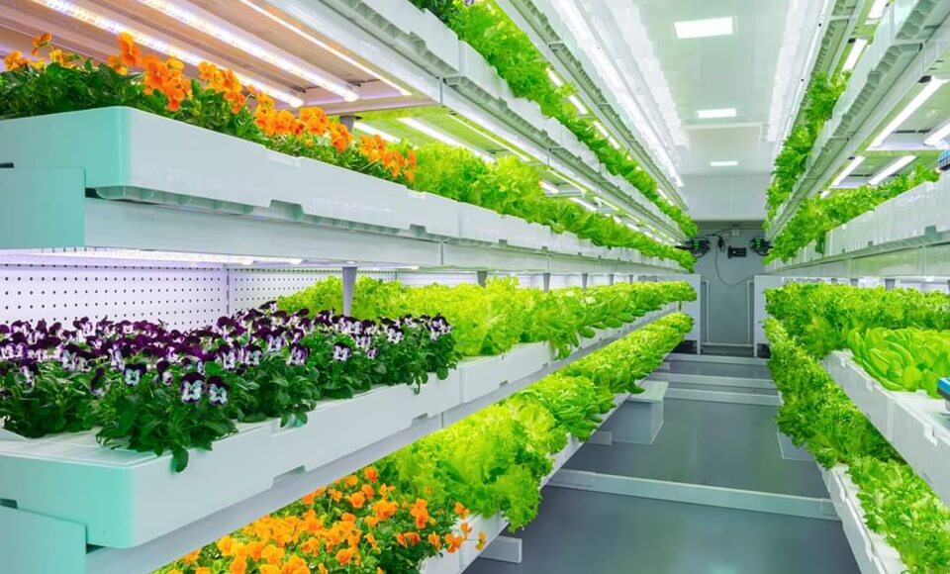
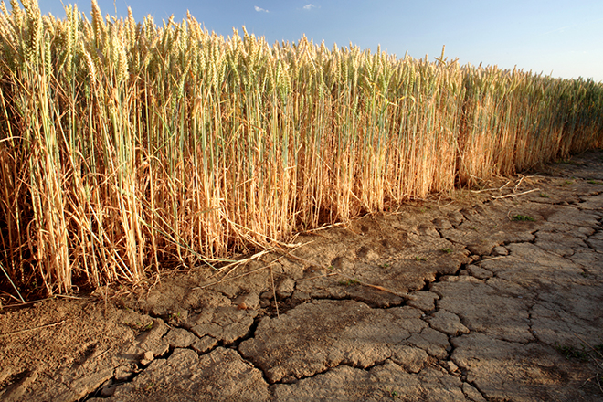
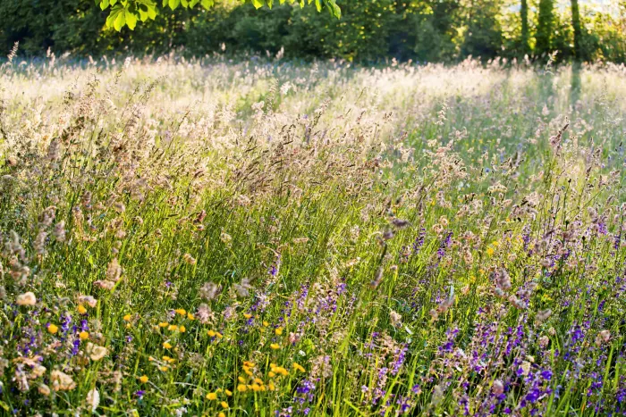
Optimize plant performance in fluctuating environments

Slide 3
growth
Resilience

Slide 4




Photosynthesis
Starch/sucrose
reserves

Slide 5
starch
Early night

Slide 6
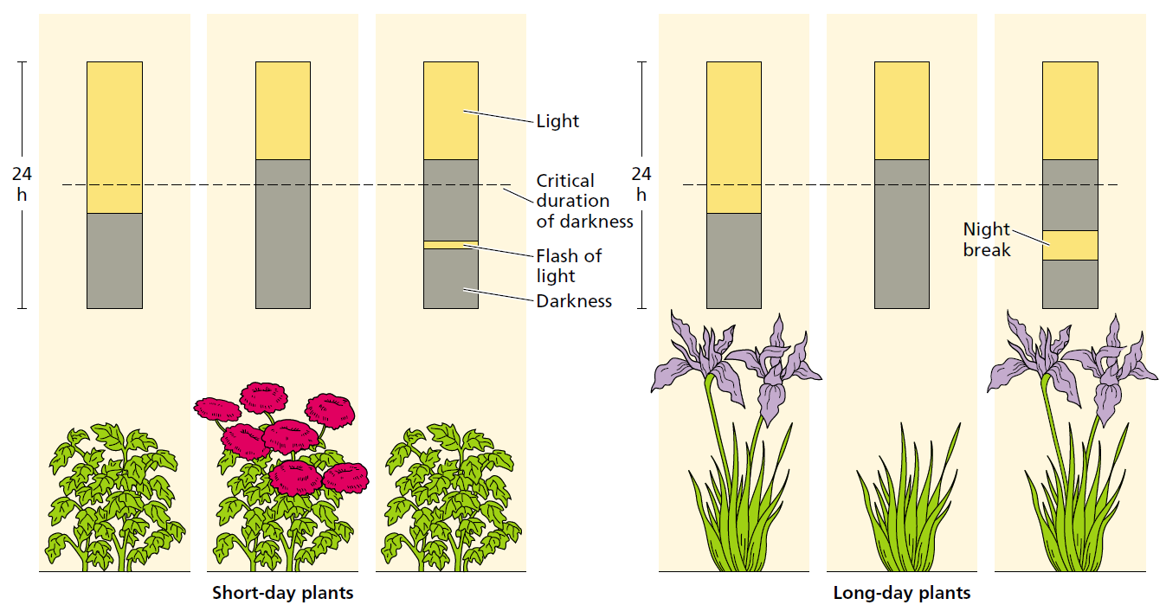

Slide 7
ztl-1: ~28 hours
toc-1: ~20 hours
CCA1-ox: no rhythm
Dodd et al. 2005, Science

Slide 8
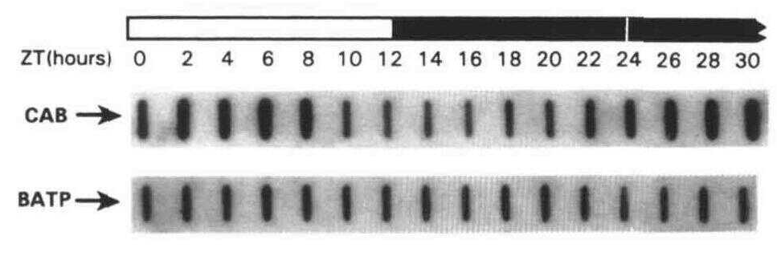
(Millar et al. 1991, The Plant Cell)

Slide 9
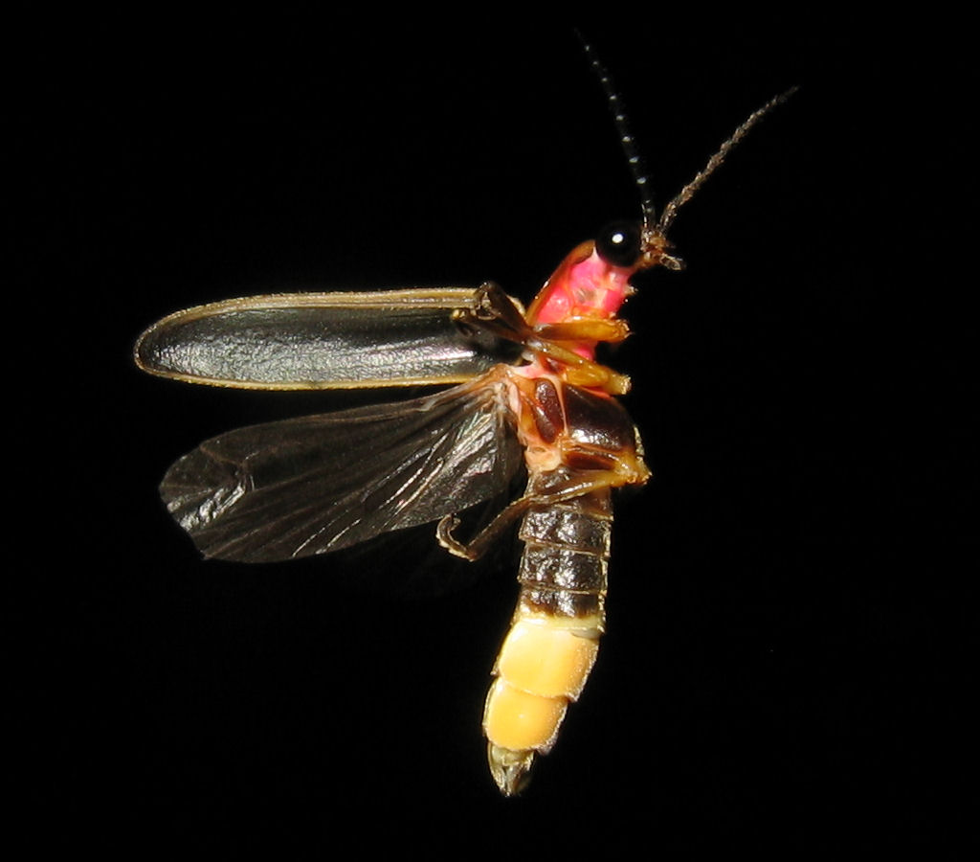
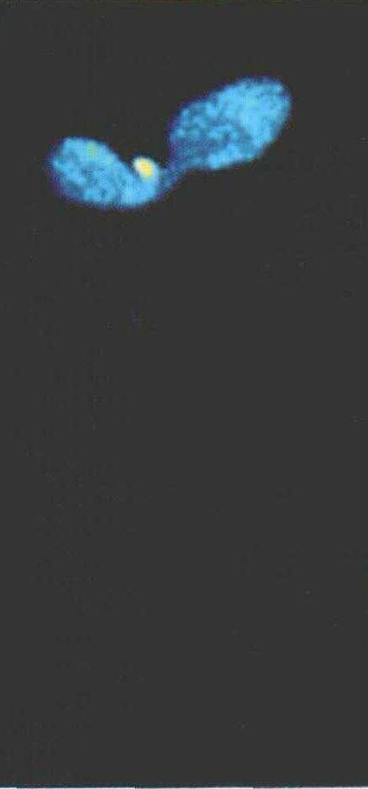
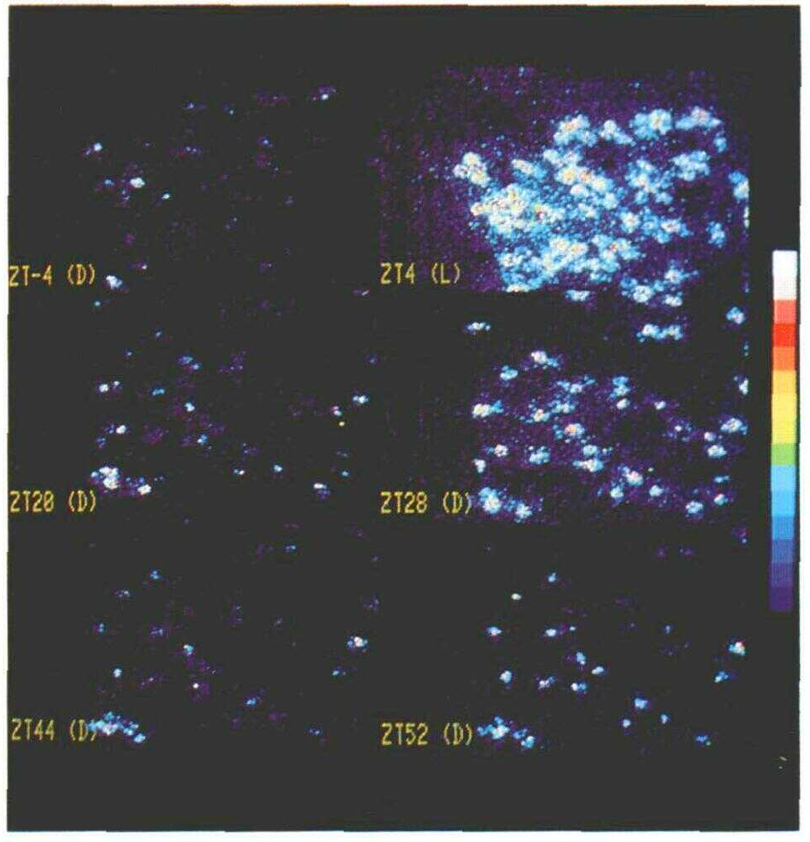
Promotor CAB
Luciferase coding sequence
Firefly Luciferase
(Millar et al. 1992, The Plant Cell)

Slide 10
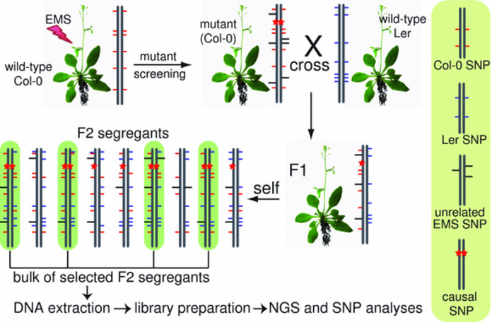

Slide 11
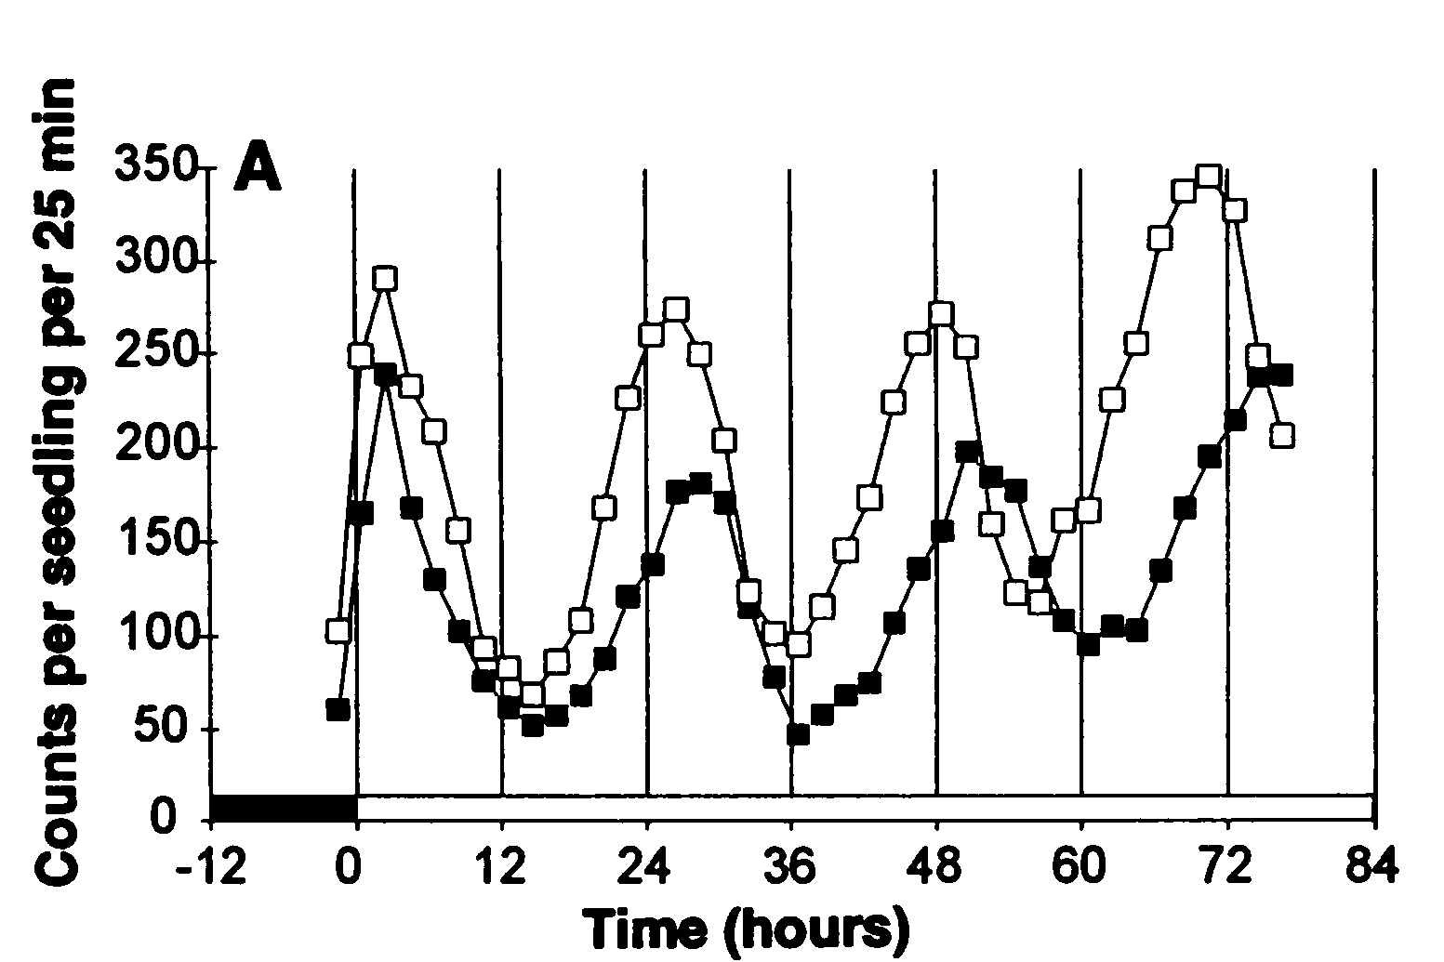
Open squares: wild type
Filled squares: toc1-1

Slide 12
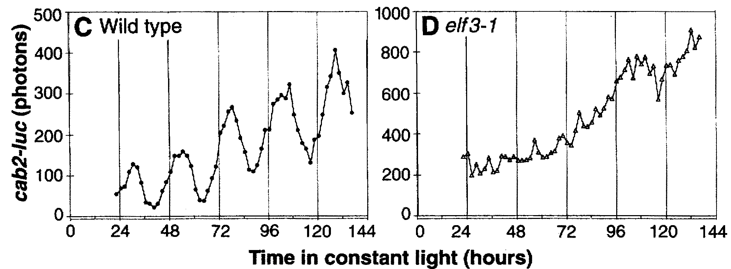

Hicks et al. 1996, Science
Zagotta et al. 1996, The Plant Journal

Slide 13
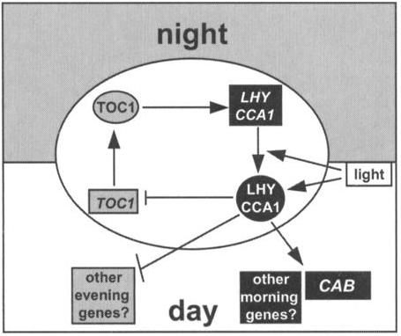
Alabadi et al. 2001, Science

Slide 14
Haydon et al. 2010, Journal of Experimental Botany

Slide 15
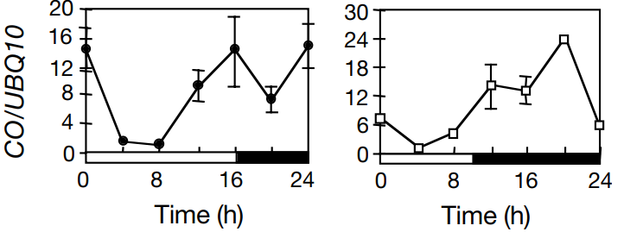
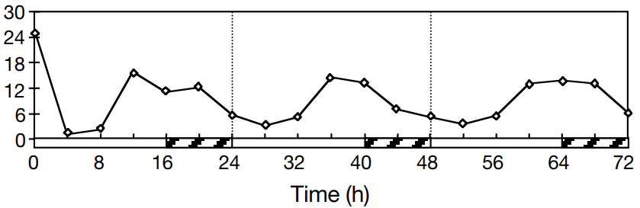
CO transcription peaks
at dusk in LD and at night in SD
Suarez-Lopez et al. 2001, Nature

Slide 16
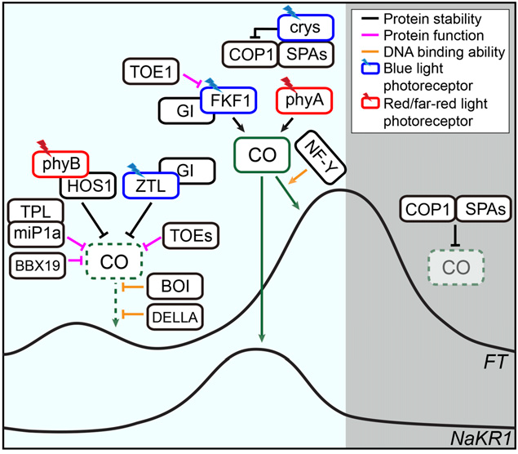
Shim et al. 2017, Plant Physiology

Slide 17
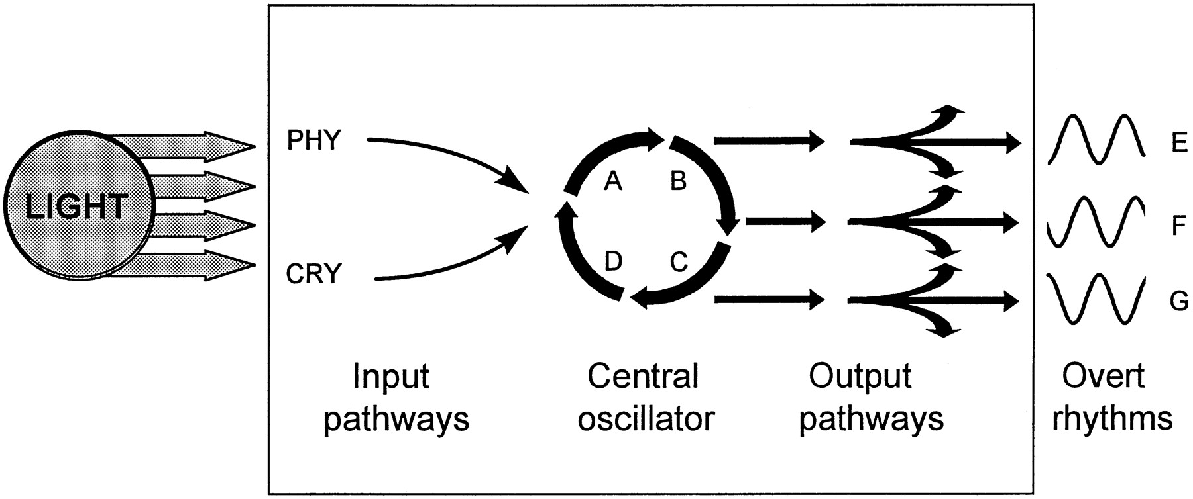
Somers 1999, Plant Physiology

Slide 18
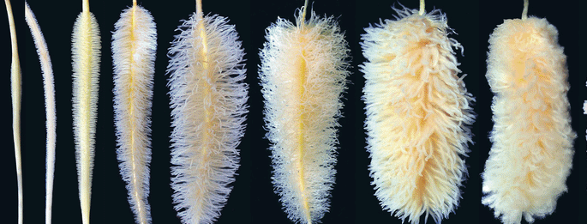
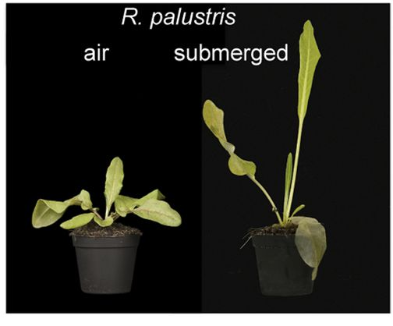
How does a clock make a plant flexible?
growth
Resilience

Slide 19
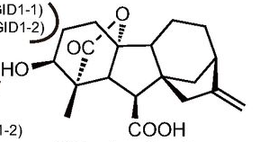
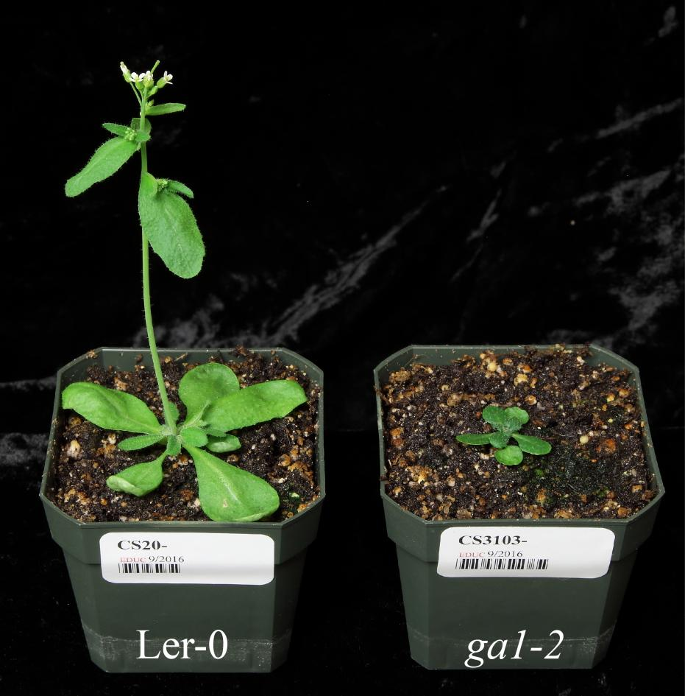
Gibberellin (GA)
growth & development
Photosynthesis
Starch/sucrose
reserves
Mann et al. 2017

Slide 20
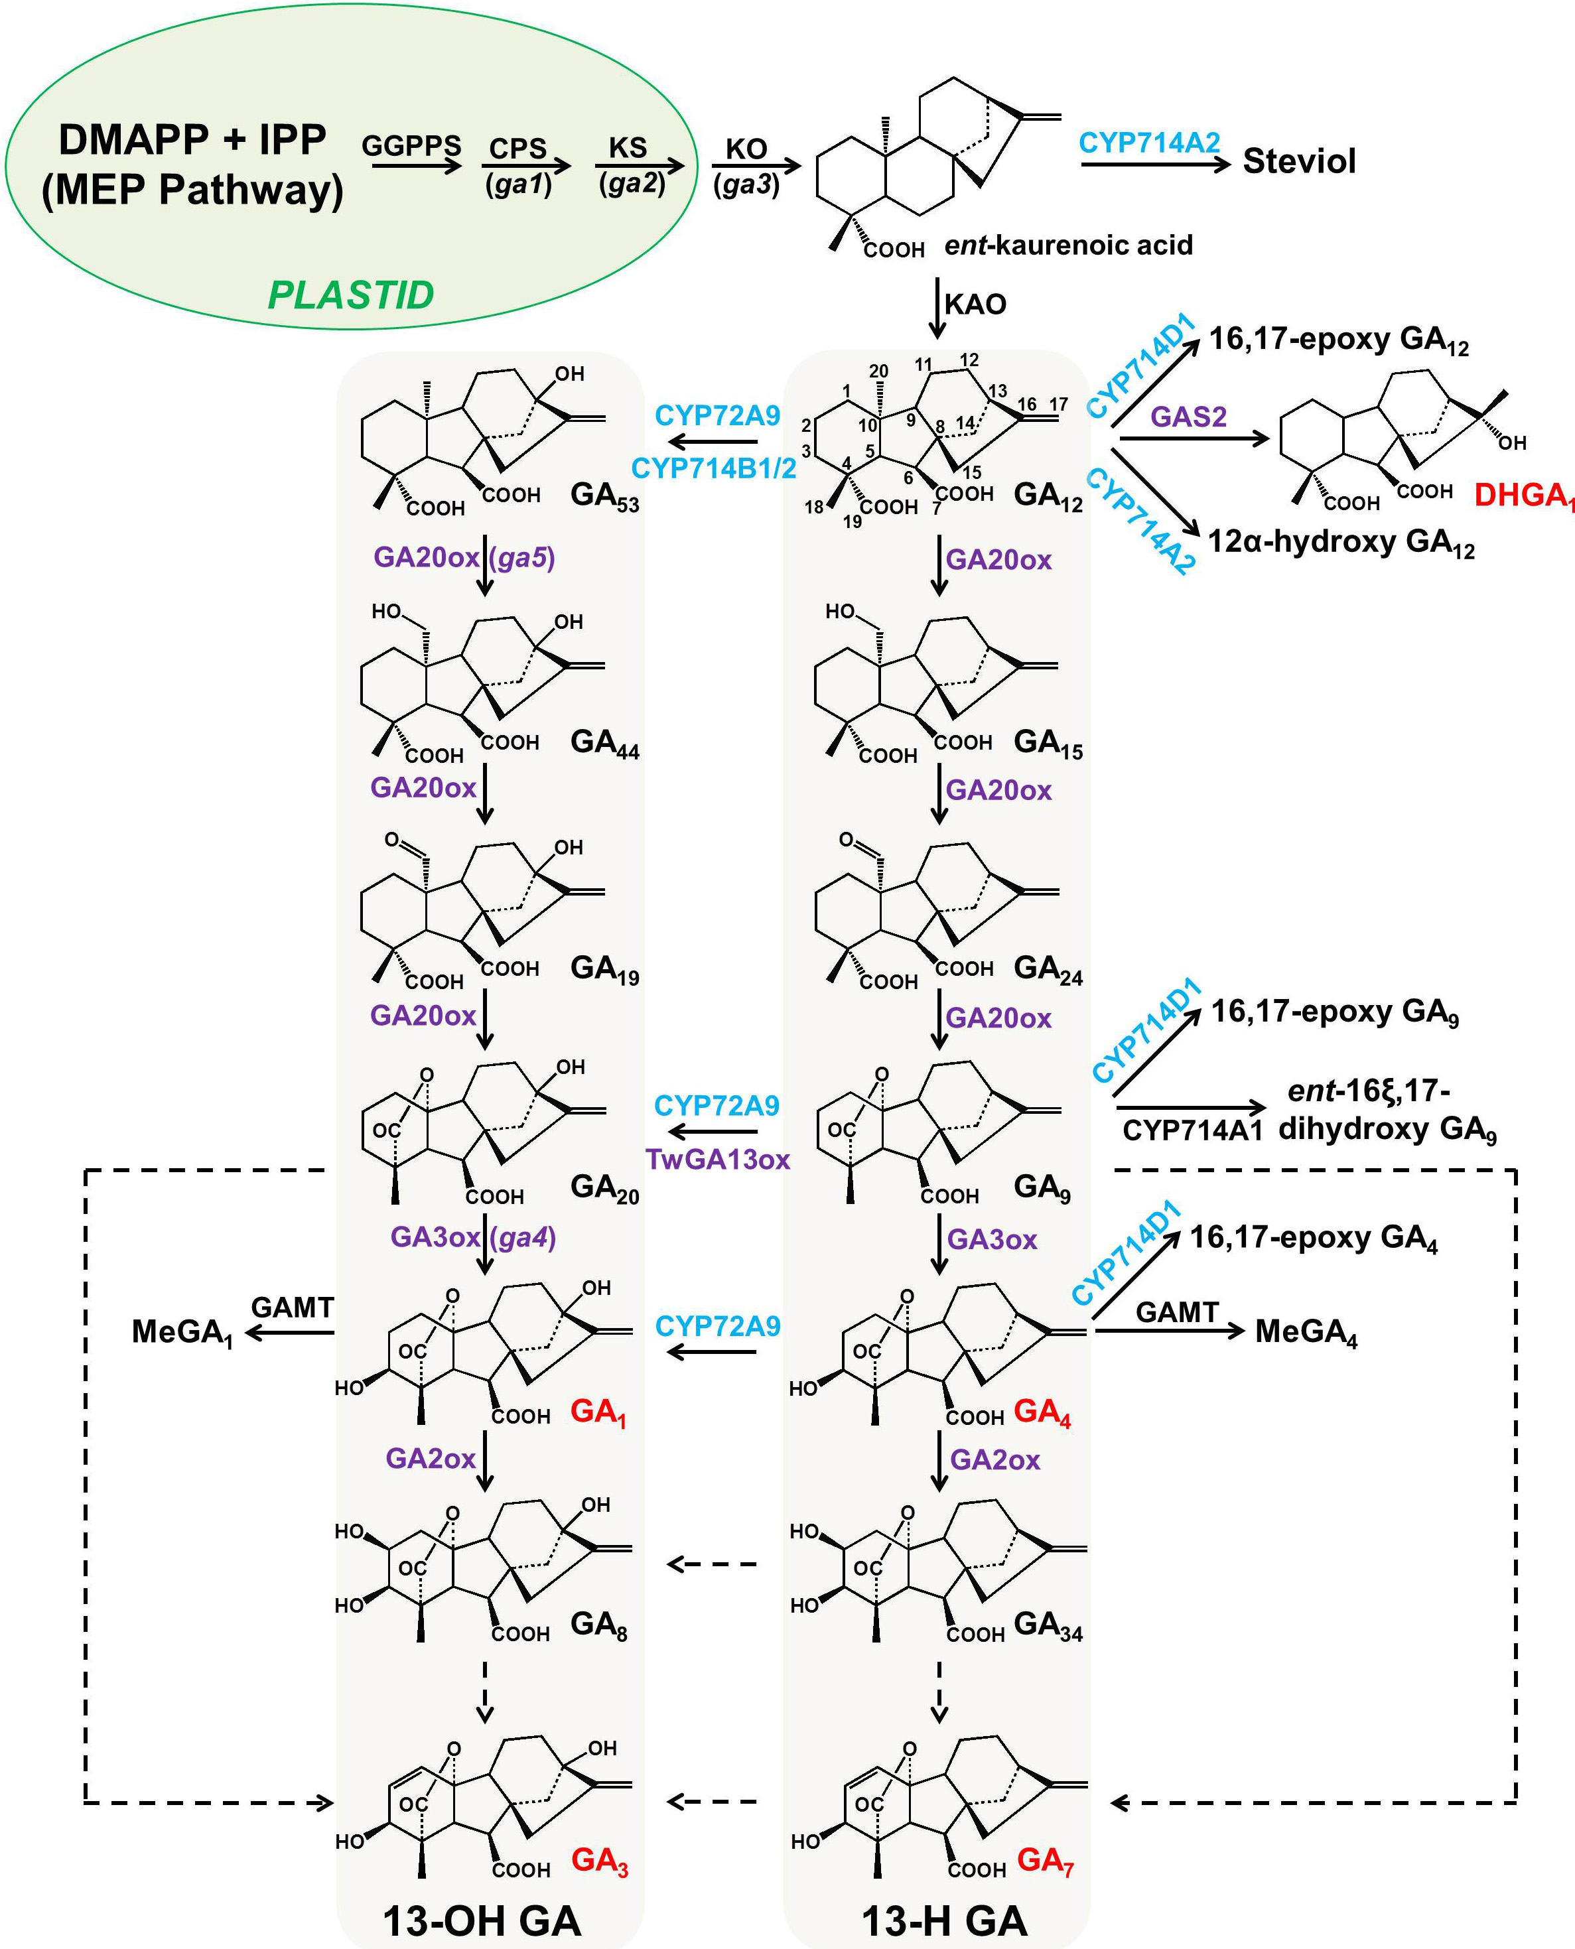
Gibberellin metabolism (GA)
He et al. 2020; Frontiers in Plant Science

Slide 21



GA feedback regulation
Gibberellin metabolism (GA), simplified
GA_{20ox}
GA_{3ox}
GA_{2ox}
…
…
GA₁₂
GA₉
GA₄
GA₃₄
GID
DELLA
GA responses
Notes:
It is hardly known which TFs activate GA biosynthesis
BR is involved
Genes involved in matching growth and hormones must be rhythmic.
Involved in vegetative growth

Slide 22
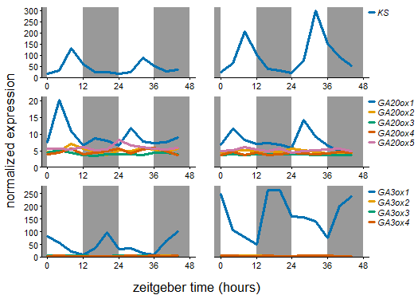

Slide 23
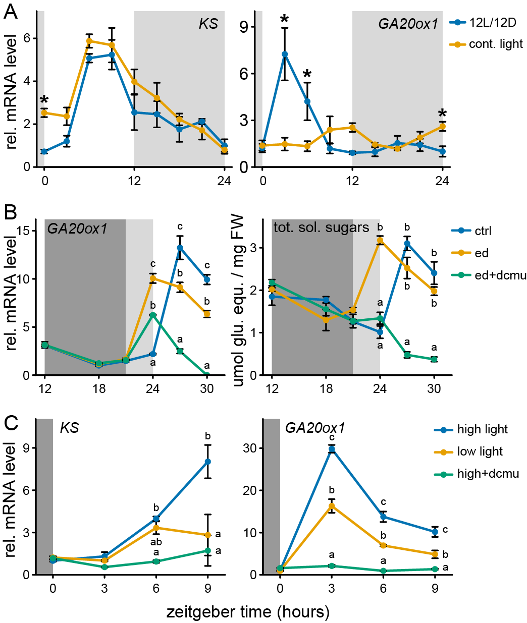

Slide 25
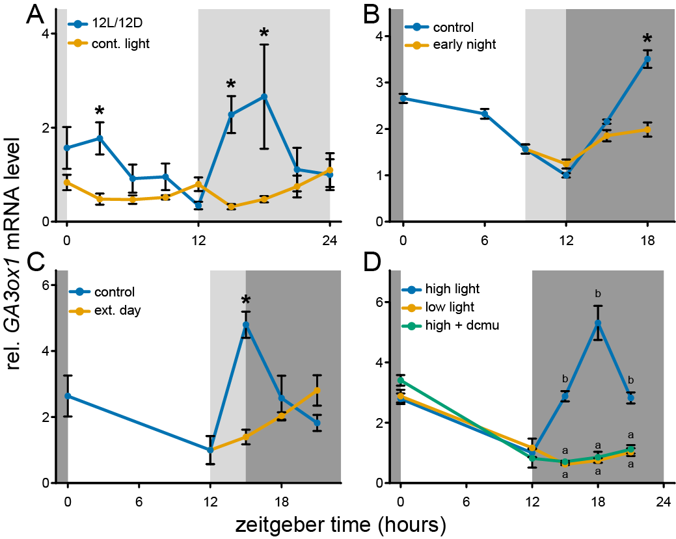

Slide 26
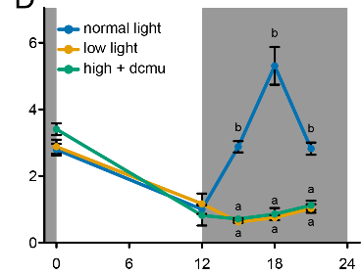
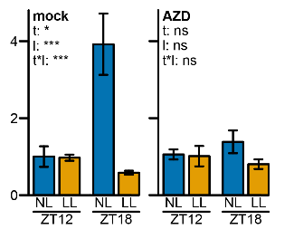
Zeitgeber time (hours)
AZD:
TOR kinase (energy signalling) inhibitor

Slide 27




KS
GA3ox1
GA20ox1

Slide 28
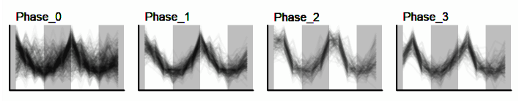
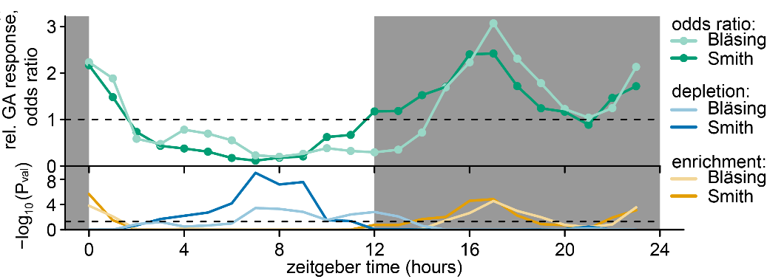

Slide 29
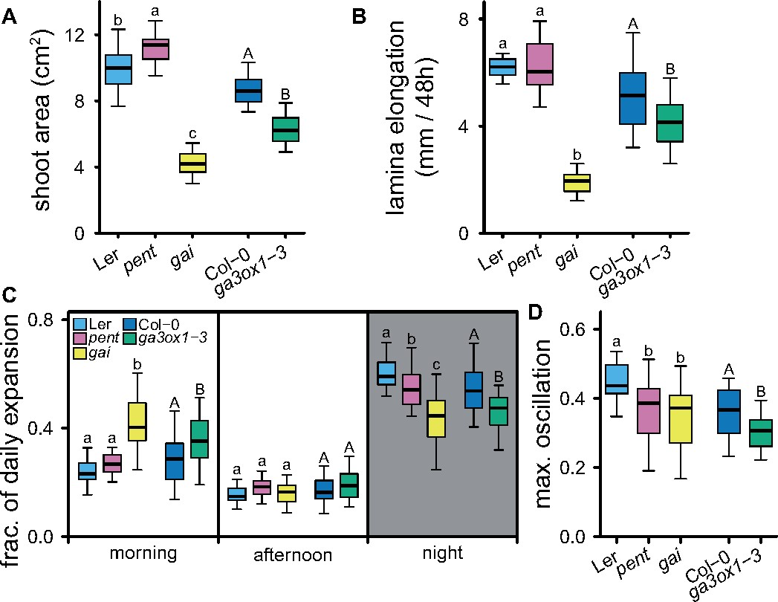

Slide 30
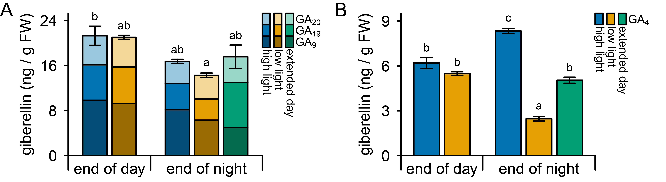
Precursors
Bioactive

Slide 31
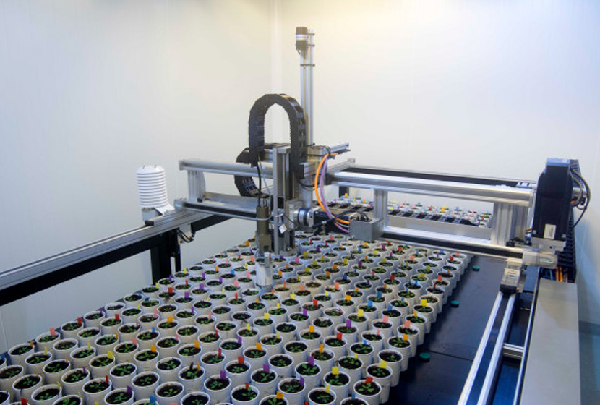
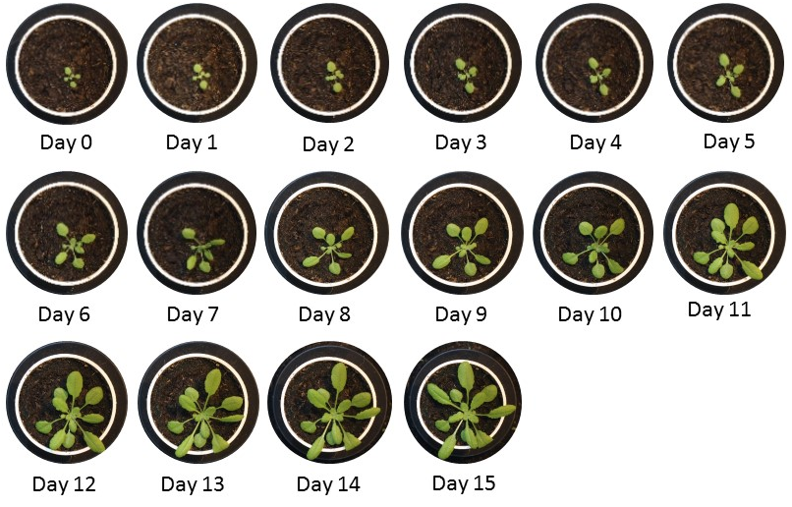
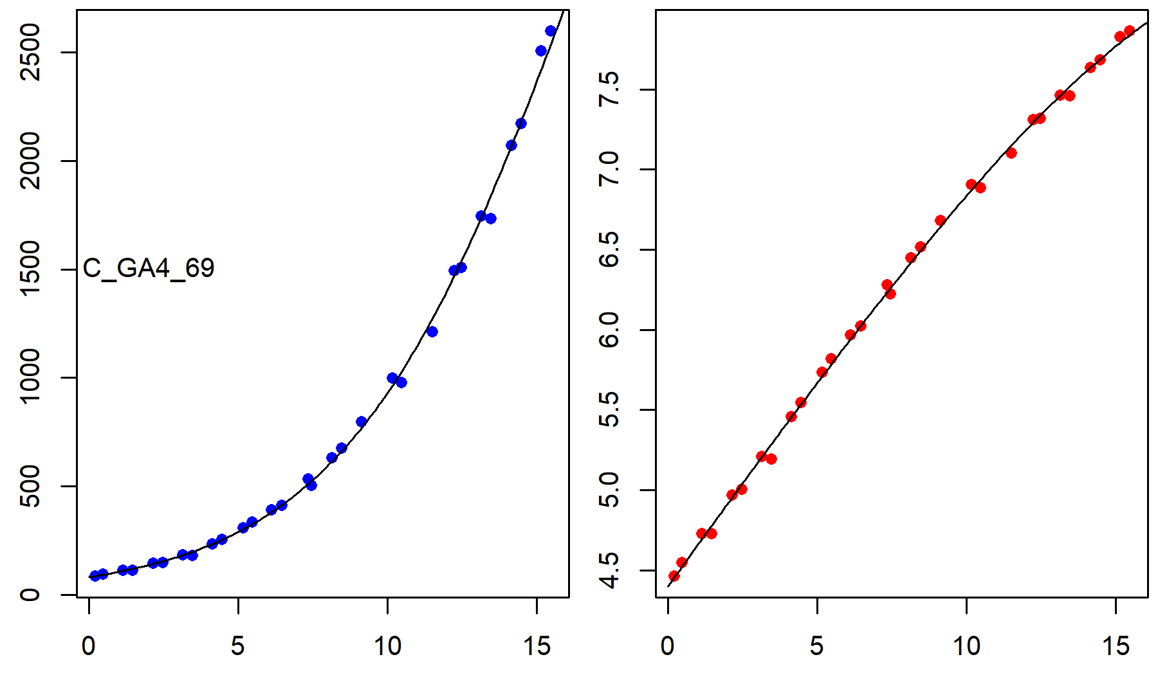
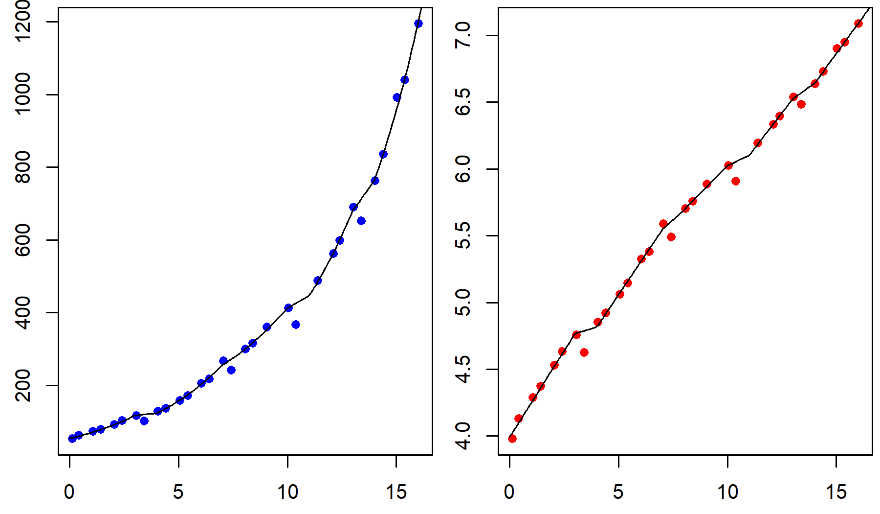

Slide 32
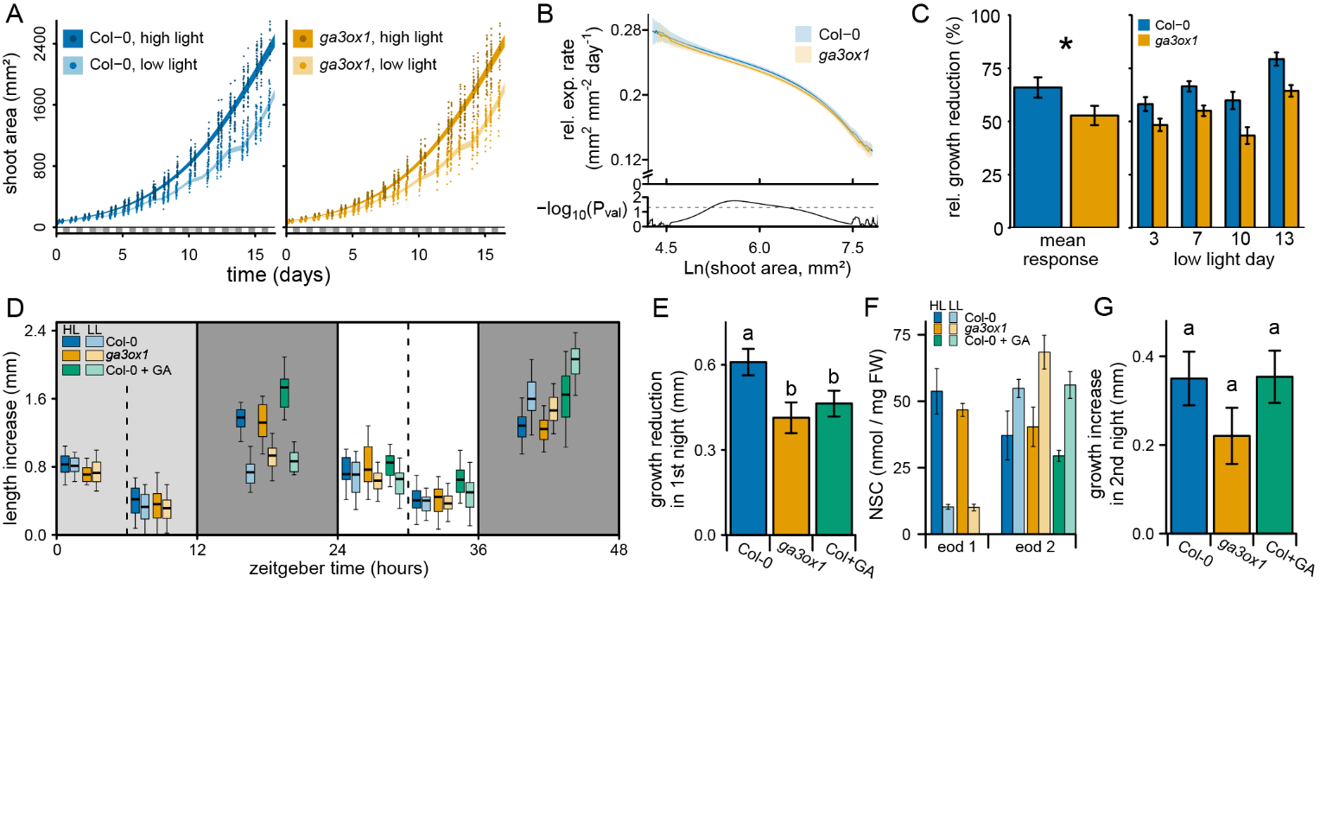

Slide 36
GID1A
KS
GA3ox1
GA20ox1
The rate limiting steps varies throughout the day
Daily turnover of GA3ox1
Higher longevity of GA20ox1 and KS
Extent of GA₄ biosynthesis depends on carbohydrates

Slide 37
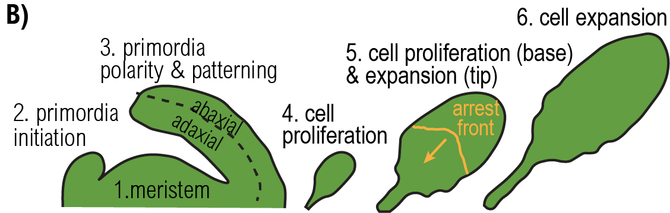
Where should pacing occur?
Strong sink
High flexibility
Aids resource homeostasis
Source / Self sufficient
Developmental constraints
Cannot adjust whole plant maintenance costs

Slide 38
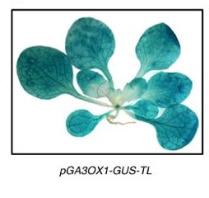
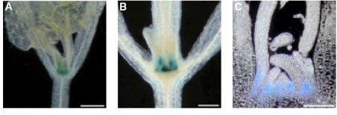
Localization of Gibberellin catabolic enzymes

Slide 39
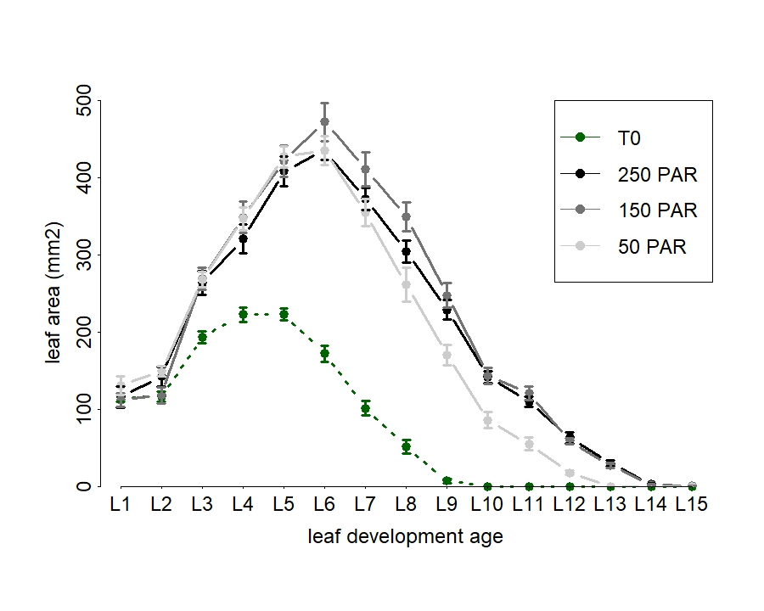

Slide 40
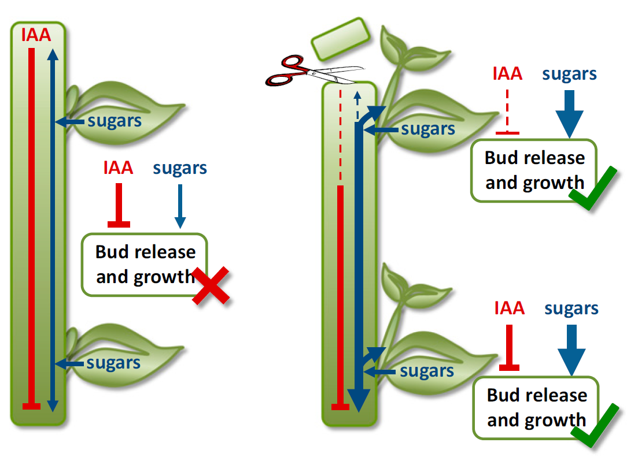
Sugars, not auxin determine lateral bud outgrowth
Mason et al. 2014, PNAS

Slide 41
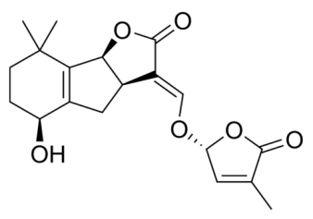
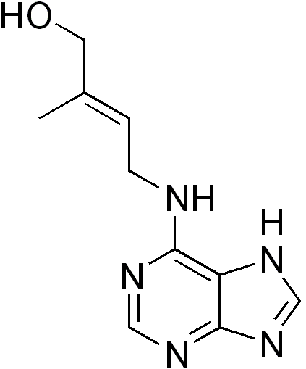
Plant development is integrate with resource availability
Strigolactone
Low P
high N
Cytokinin
Mason et al. 2014, PNAS

Slide 42
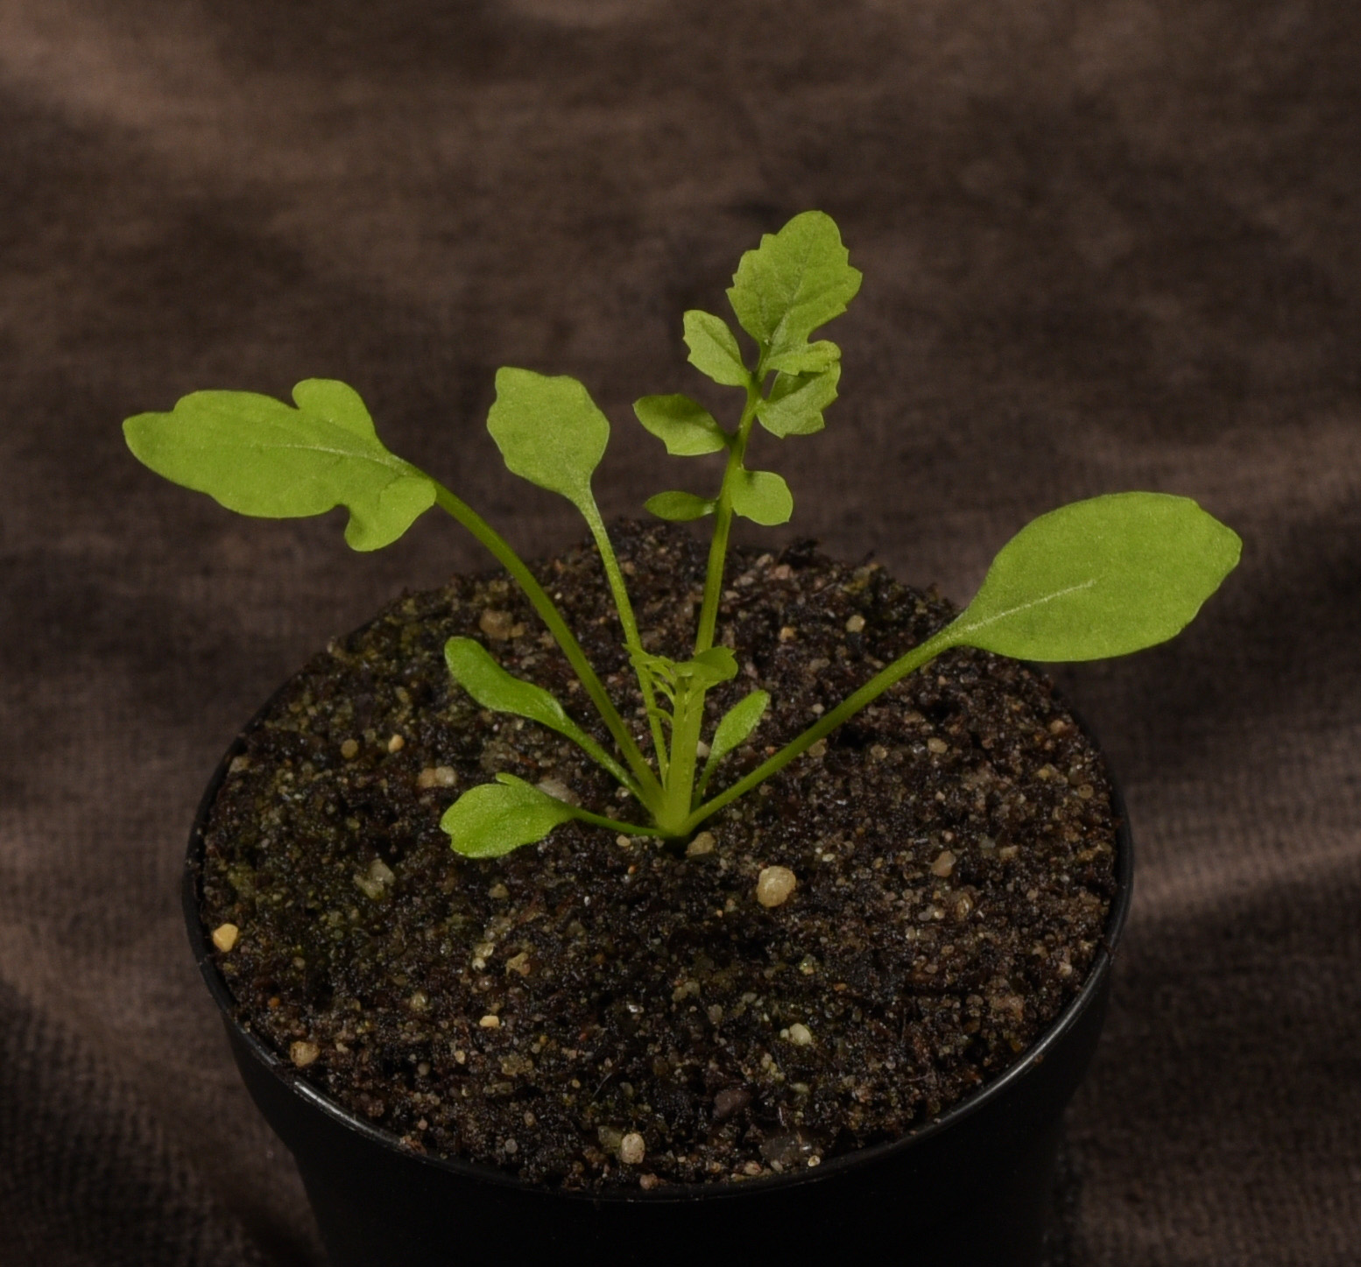
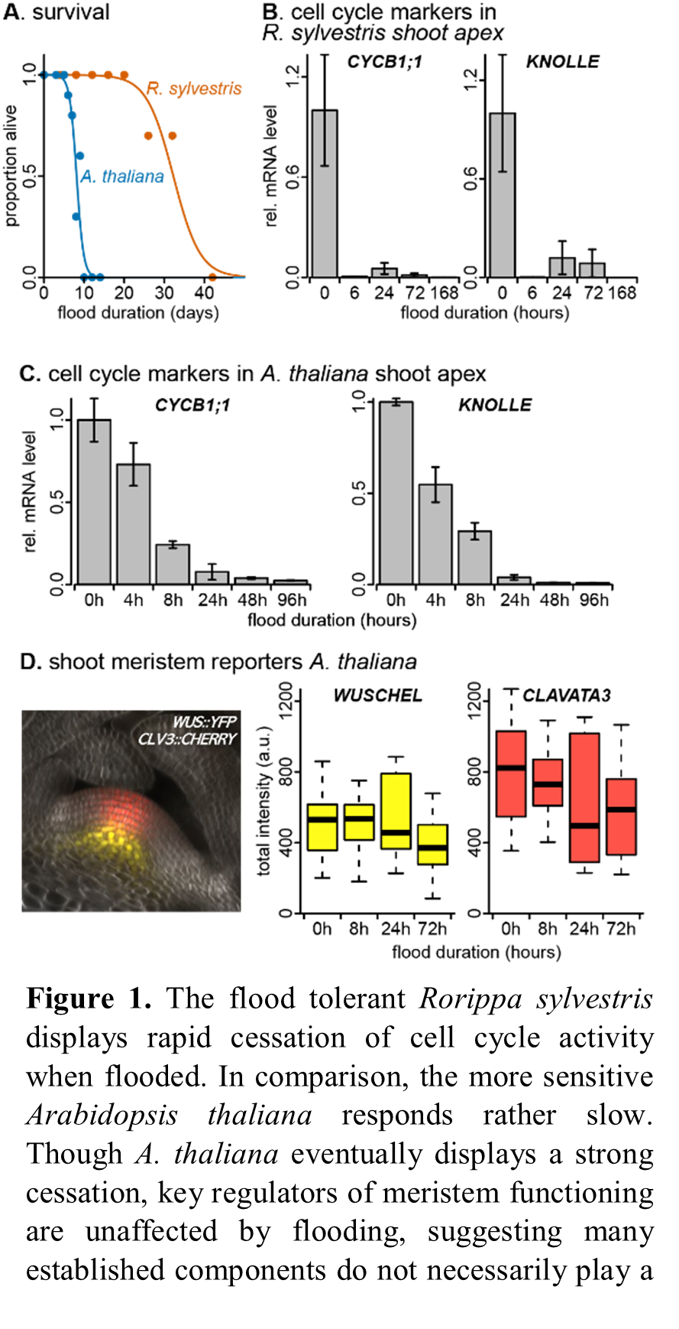
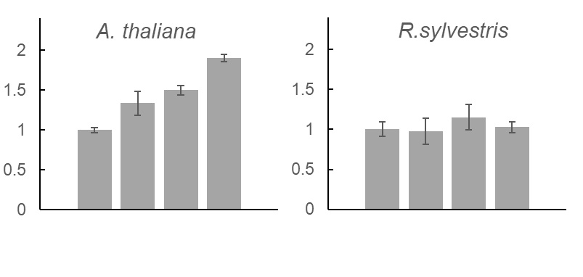
Shoot apex activity upon flooding
can be uncoupled from energy abundance depending on the species
Rorippa sylvestris
CYCLINB1;1 during flooding
CYCLINB1;1 with sucrose and flooded
A. thaliana
R. sylvestris
0 15 30 45
0 15 30 45
flood duration (hours)
Sucrose in floodwater (mM)

Slide 43
Wheat flowering time must match abiotic requirements

Slide 44
Local barley adaptations
PRR7
ELF3

Slide 45
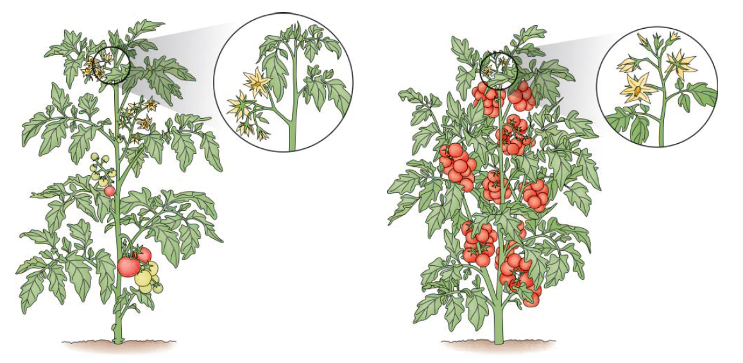


Have we created high yielding miracles, or fragile green athletes?
Teosinte
Maize
Indeterminate growth
Wild type
Determinate growth
domesticated
Notes:
Credits: all images Wikicommons, licensed for reuse freely

Slide 46



Evo-Ecophys, Groningen
Joe Earle
Jundong Huang
Marten Staal
Jan Henk Venema
Joe Earle
Putri Prasetyaningrum
SSSUP and Unipi, Pisa - Italy
Putri Prasetyaningrum
Giacomo Novi
Maria Christina Valeri
Pierdomenico Perata
Lorenzo Mariotti
VIB Gent
Stijn Dhondt
Dirk Inze

