Slide 1
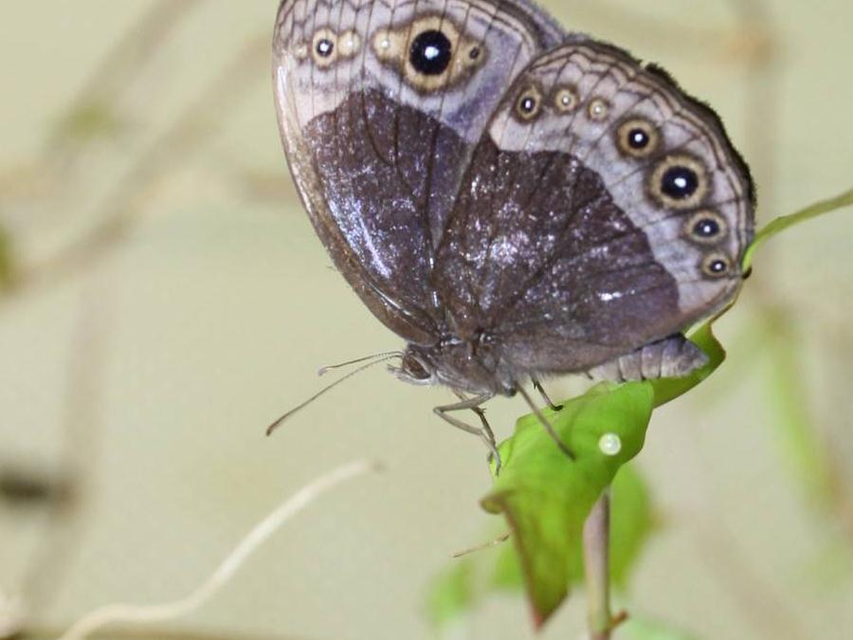

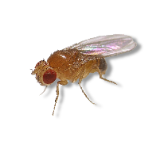


Wordt de mens in de toekomst 145 jaar?
Bas Zwaan – Laboratory of Genetics – Wageningen University

Slide 2
Outline:
A few conceptual things we need to know
What are the patterns we observe?
What does the current state-of-the-art tell us?
Formulating the answer ...

Slide 3

What is ageing?
Ageing is the total effect of those intrinsic changes that accumulate in the course of life that negatively affect the vitality of the organism, and that makes it more susceptible to the factors that can cause death.

Slide 4
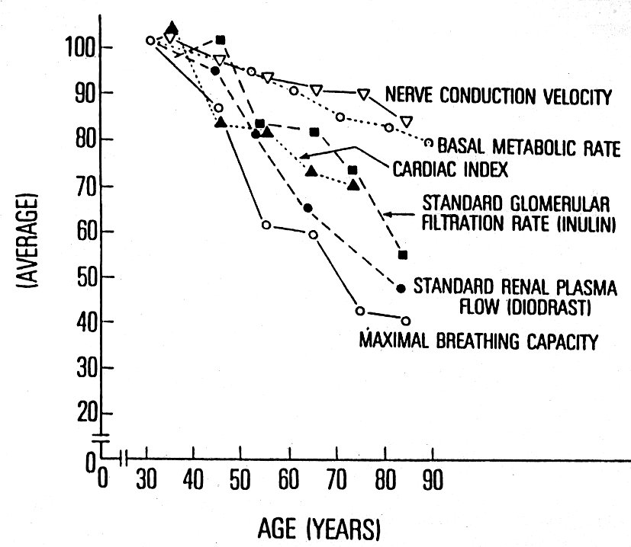
Things do not get better with age……

Slide 5
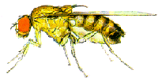
Statistical definition of ageing
ageing
no ageing

Slide 6
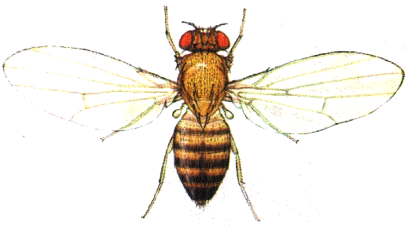
Mortality is the sum of intrinsic and extrinsic factors
Natural environment
Protected environment
Mortality: m_{total} = m_{environment} + m_{intricsic}

Slide 7


Evolutionary explanation of ageing
Natural selection: maximal reproductive output within the natural lifespan
100
80
Very strong
Very weak
60
survival
selection shadow
40
In our evolutionary past
20
0
0
20
40
60
80
100
age (years)

Slide 8
Evolutionary explanation of ageing
Constraining environmental mortality in human population has exposed life in the selection shadow
100
1980
80
1960
1935
1900
60
survival
1800
selection shadow
40
In our evolutionary past
20
0
0
20
40
60
80
100
age (years)

Slide 9
Evolutionary explanation of ageing
Ageing is non-adaptive and mechanisms evolved via two main routes
Strong selection for early life fitness at the expense of late-life health
Late-life consequences
Selection for genes with antagonistic pleiotropic effects
Common principles: public phenotypes and mechanisms
Lack of selection for late-life fitness/health
No early-life consequences
Accumulation of deleterious mutations with late-life effects
Contingency: private phenotypes and mechanisms
Public - Shared
Private - Unique

Slide 10
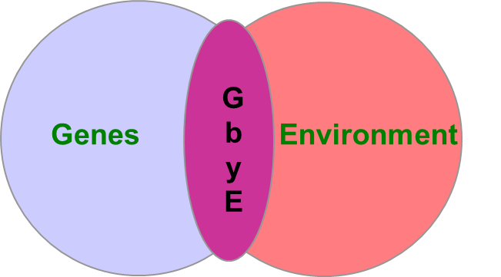



What explains variation in lifespan and ageing?
Thrifty genotype
Thrifty phenotype
Evolutionary mismatch
Our genomes are expressed in environments that they were not adapted to through natural selection
Developmental mismatch
Predictive Adaptive Responses (PAR)
Developmental Origin of Health and Disease (DOHAD)

Slide 11
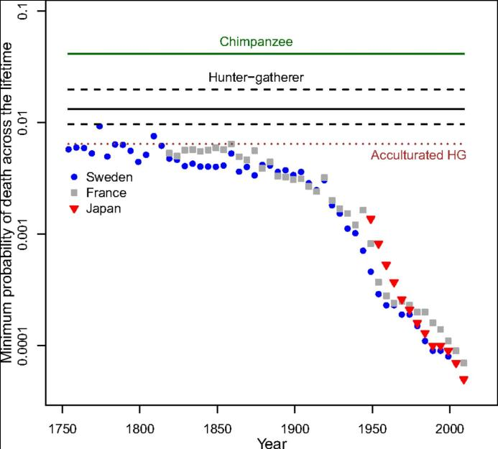
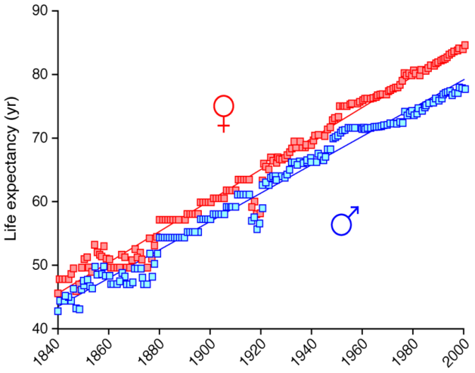
What are the patterns we observe? the role of the environment
“72 is the new 30”
Westendorp, R.G.J. (2004)
Burger et al. (2012)
... mortality improvement in humans is on par with or greater than the reductions in mortality in other species achieved by laboratory selection experiments and endocrine pathway mutations ....
mortality reduction has been experienced by only about 4 of the roughly 8,000 human generations (rules out genetic change)
Thus, increase achieved by environmental changes
variation in lifespan and ageing is still there

Slide 12
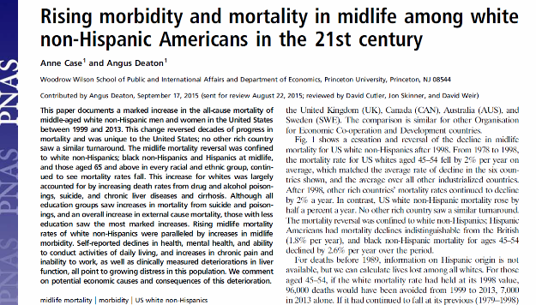


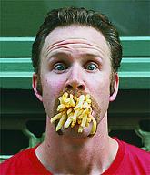
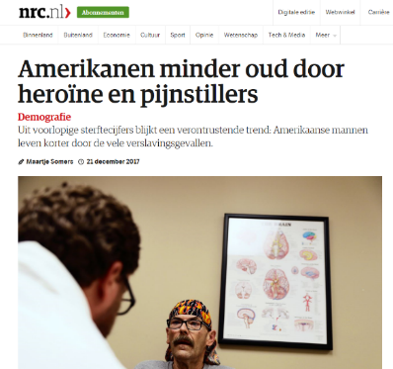




Examples of Evolutionary Mismatch, GxE?
Too little
Just right
Too much
natural selection

Slide 13
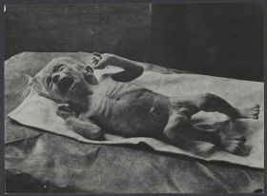
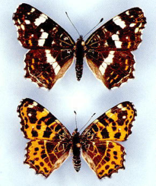
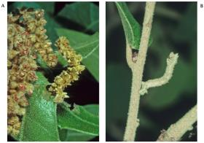
Linking development to ageing
Some characteristics of development
Robustness: despite strong perturbations retains its focus
Plasticity: Phenotypes are shaped by environmental variables
Araschnia levana, the European map butterfly
Nemoria arizonaria
Notes:
Spectacular PP in biology are an inspiration for observations in humans. But is it adaptive?

Slide 14
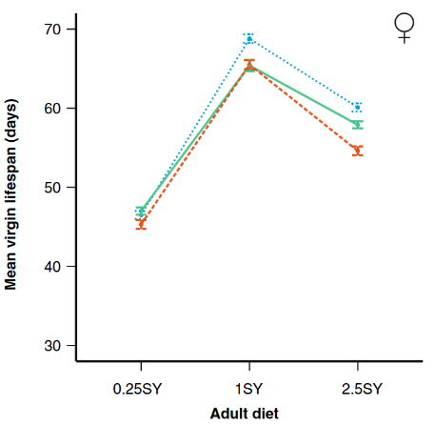
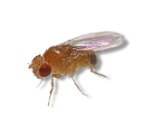
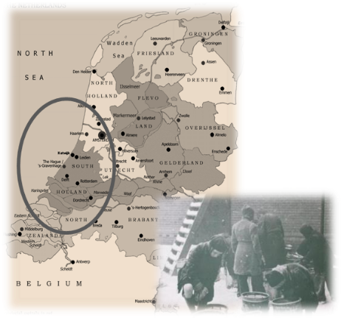

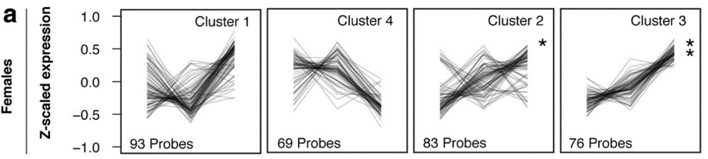
Beyond evolutionary storytelling
Questions to be addressed regarding plasticity phenotypes
Why would they evolve?
What is the potential functional significance?
Can they evolve under realistic scenario’s?
Can they evolve in humans?
Which mechanism is (more) likely to be evolve?
Dutch Hunger Winter cohort
Why does early prenatal exposure to poor nutrition cause life-long changes in DNA methylation?
Ribosome biology

Slide 15
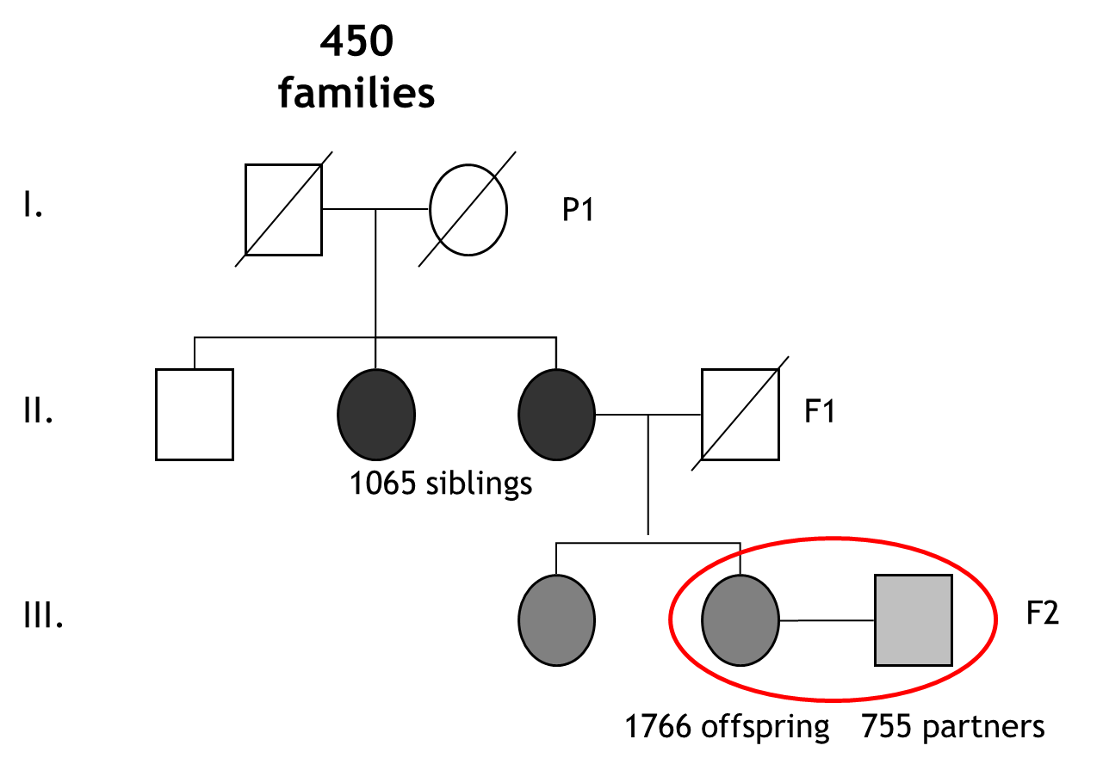
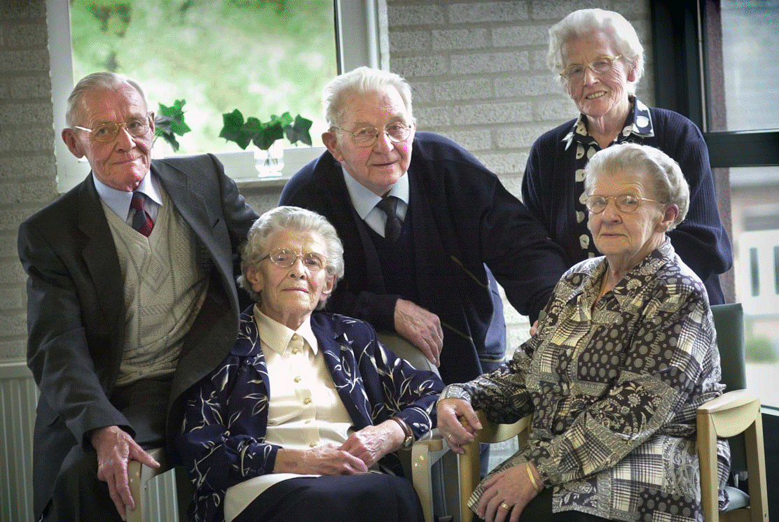

What are the patterns we observe? the role of genetics
Heritability estimates
$h^{2}=\frac{V_{G}}{V_{P}}$
Twin studies in humans: ̴ 0.25
Leiden Longevity Study (LLS)
Lucassen siblings (86-93 years)
Notes:
15

Slide 16
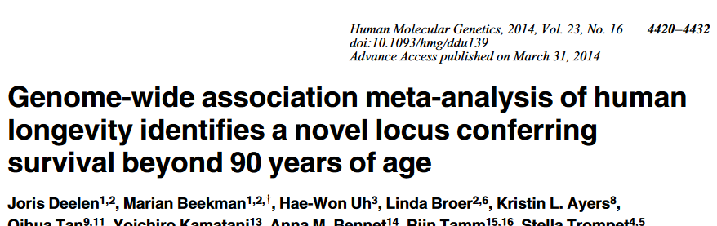
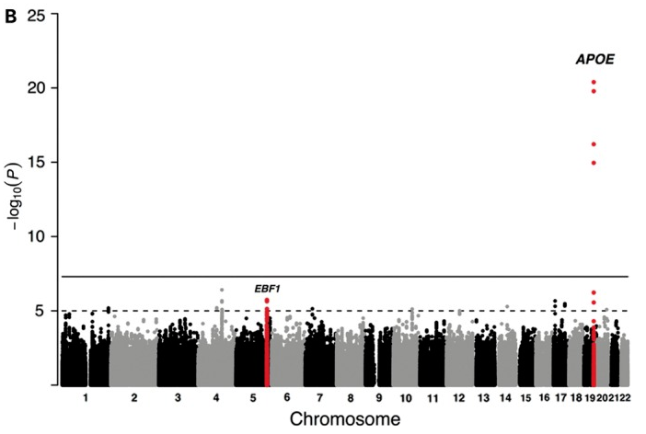
What are the patterns we observe? the role of genetics
Similar design across Europe
Should we be surprised?
Evolutionary theories predict “public” and private alleles
Little “additive” genetic variance expected
GWAS can find “additive” effects very well for “common alleles”
Rare variance and non-additive loci will not be uncovered
Well-know pleiotropic gene
Related with low blood pressure in middle age

Slide 17
What are the patterns we observe? the role of genetics
Starting population and experimental design
EE well replicated (4x)
Life history phenotypes measured multiple times throughout EE
  development time
  larval survival
  fecundity
  Lifespan
Pooled resequencing: ~115/58 generations of selection (early/late)
  250 females per population
  ~70-100x coverage
  ~1.2 million SNPs

Slide 18
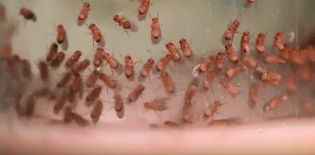
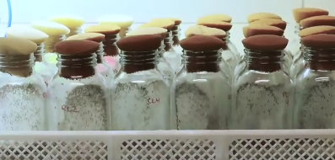
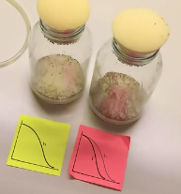
Evolution of LH traits
Late reproducing flies live longer and take longer to develop

Slide 19
Finding the genes that matter
Notes:
Figure 2: Significantly differentiated SNPs as identified with GLM (A-C) The Manhattan plots indicate regions of SNP allele frequency differentiation across the genome for the two main factors, "Developmental diet" and "Age-at-reproduction", and their interaction. Significantly differentiated SNPs are indicated in red. (D) A number of SNPs have differentiated in response to multiple factors (i.e. both main effects, one of the main effects and the interaction, or all three factors) and hence there is overlap in both SNPs and genes among the three groups.

Slide 20
Finding the genes that matter
Complete physical interaction network
Genes interact more often than expected by chance
Many “biological processes” involved
Notes:
Figure 4: Physical interaction network. The complete physical interaction network is shown and subsets of genes in which significant SNPs fall are indicated with colored circles. Genes that were significant for "Developmental diet (A), Age-at-reproduction (B) and the interaction of the two regimes (C) as determined by the GLM analyses are shown. There is a significant clustering for genes significant for "Age-at-reproduction" and "Interaction". The "Interaction" genes also have a significantly higher number of direct connection compared the mean of all genes in the network.

Slide 21
What do we know?
Ageing does not serve an evolutionary function
Lifespan evolves as an integral part of the life history (LH)
LHs respond to multiple selection forces
Genetics of lifespan is complex (“public” and “private”)
Genes function in large networks, with sometimes contrasting functions/processes (pleiotropic effects)
Ageing is integrated in (many) biological systems and is not “modular” or “additive”

Slide 22
Will we become 145 years old?
Quite possibly
It is a numbers game (I once had a fly that lived 285 days when the average was 80 days)
But there is a maximum, our average lifespan will at some point cease to change .....

Slide 23
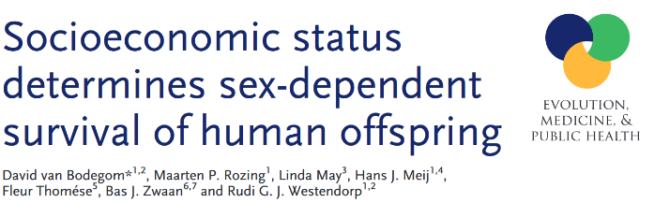
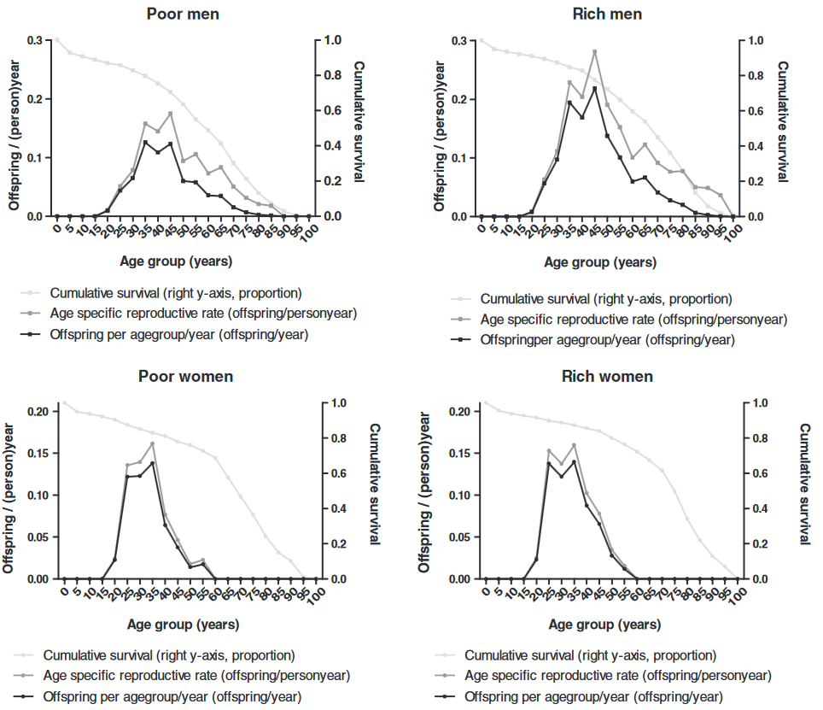
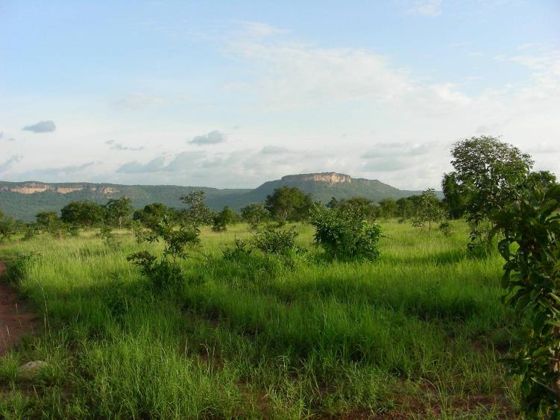
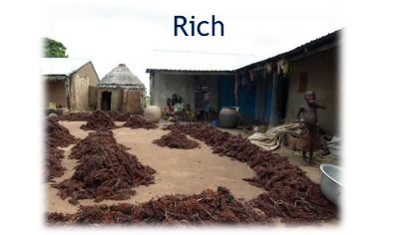
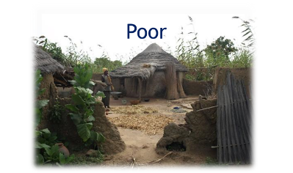
The route to healthy ageing

Slide 24
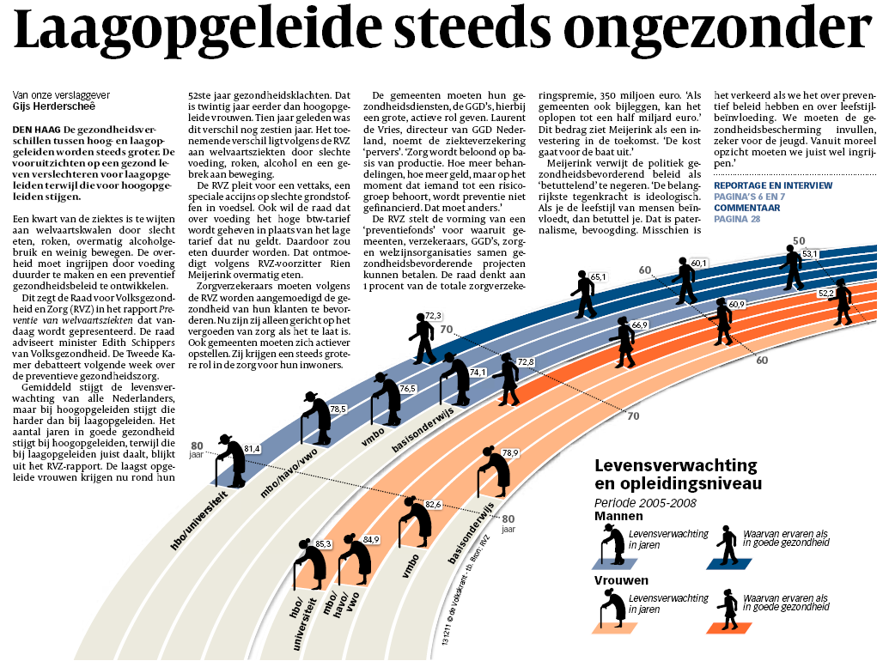
(Gezonde) levensverwachting in NL
Geslacht en educatie (SEGV)
SES & gezondheid
By courtesy of Erik Buskens, UMCG
~7j absoluut
~12j gezondheid

Slide 25

The route to healthy ageing
10 times more likely to become a centenarian

Slide 26
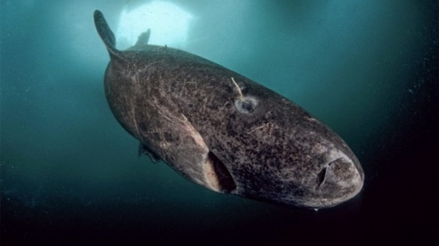
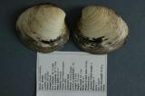
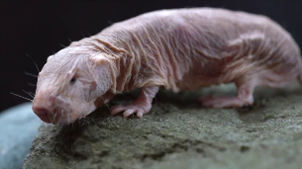
Living for 145 years
Optimism stems from long-lived organisms and the promise that if we unravel the mechanisms we can take this knowledge and “cure” our own curtailed lifespan
This is wrong for at least two reasons:
  Mechanisms of long lifespan in one species does not necessary compare with short lifespan mechanisms in another (“public” & “private”)
  Ageing did not evolve, lifespan did. Thus lifespan is integral part of LH of organisms which determines evolutionary “success”. Thus by tinkering with lifespan, you tinker with that success
Nevertheless, comparative knowledge on mechanisms in other species may help prevent and/or remediate the negative effects of ageing

Slide 27


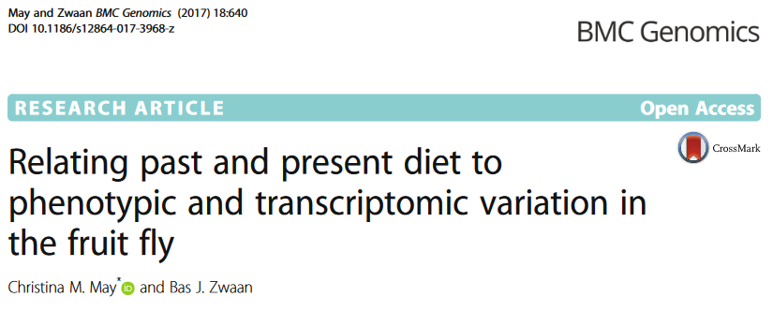
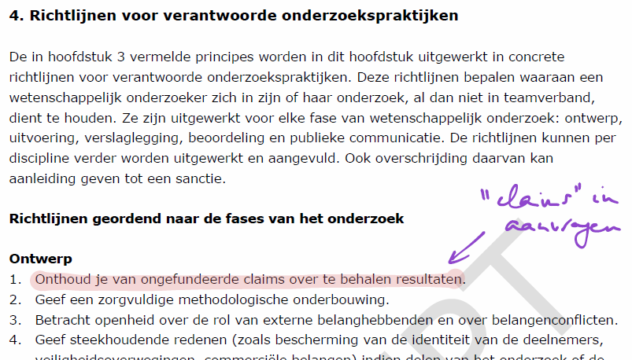

Be aware of sweeping claims ....

Slide 28
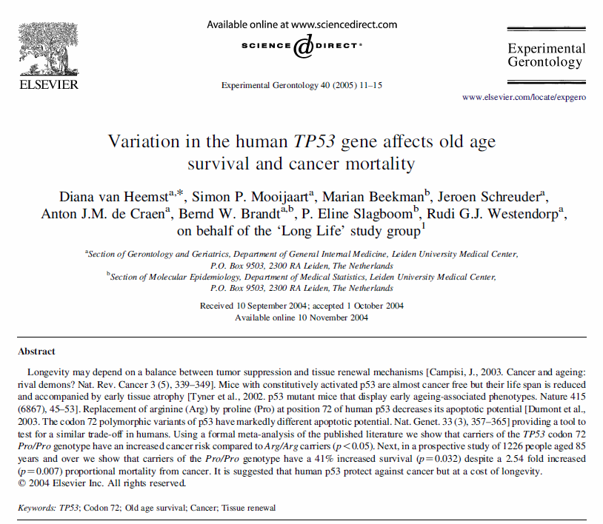
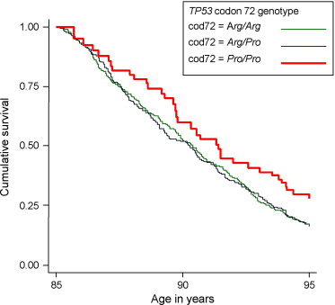
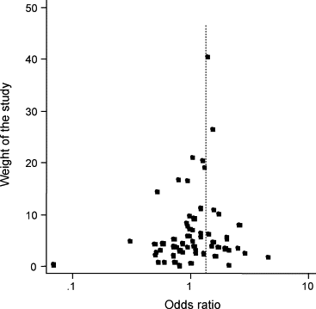
Lifespan and cancer: a trade-off
Survival advantage at old age .....
... but a cancer risk factor at younger ages!

Slide 29
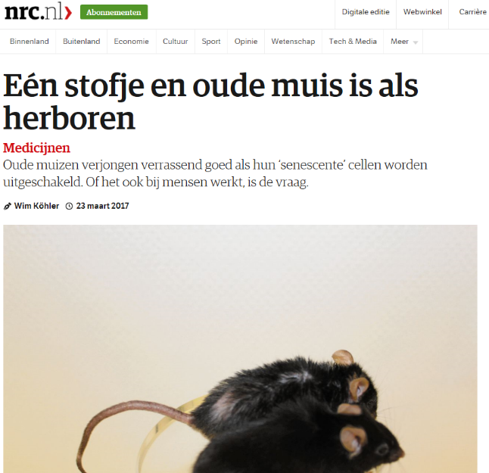
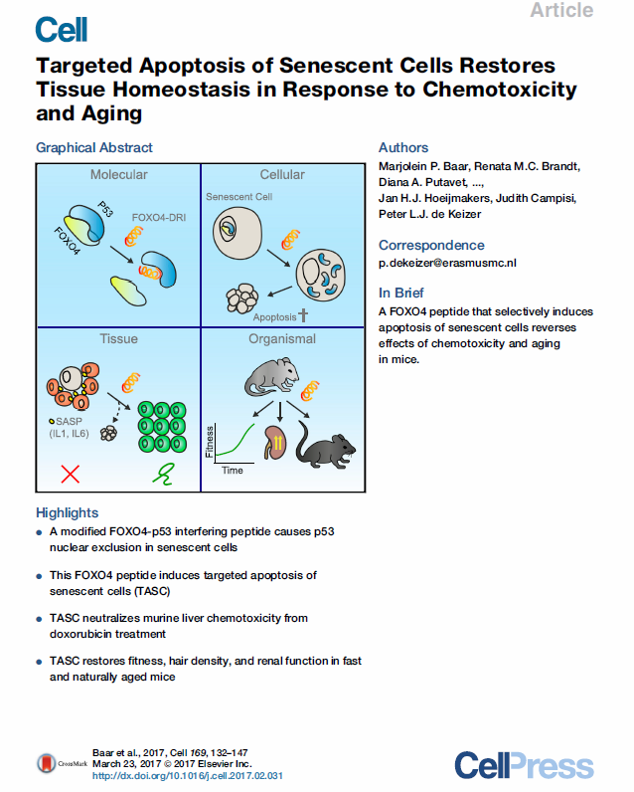
A possible hopeful mechanism
Natural selection acting on preventing cancer through senescence cells ...
... but lack of selection on inducing apoptosis (selection shadow)
“Cost free” health extension?

Slide 30
Realistic expectations
Technological advancement
  Gene technology (e.g. Crispr/Cas9)
But
  There will be very many (e.g. human height already > 1000 SNPs identified and this is a relatively “simple” and “well defined” phenotype)
  Even if we find all the genes, are we going to tweak them all together?
  But they are risk factors that interact with the environment
  And they are involved in networks and serve multiple functions – which direction should they be tweaked?

Slide 31

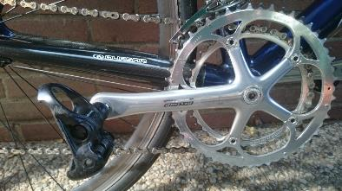
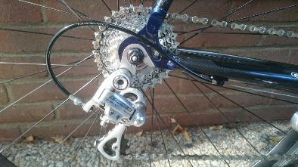
Realistic expectations
Technological advancement
  Organoids, artificial organs, ...
Parts function as a whole
Replacing one part will lead to problems
Expect “knock-on” effects
Took great care, replacing what was necessary
... but still everyone could see it was an old car

Slide 32
Realistic expectations
Technological advancement
  Organoids, artificial organs, ...
But
  Replacing parts will cause problems
  This is true even when parts can be seen as modular and have simple direct interactions to serve one-dimensional functions
  But what I have showed you today indicates that this is not the case for ageing
  Changing parts will have knock-on effects that will counteract or even reverse the lifespan extending effect
  And in addition may negatively effect the very many important biological functions, such as reproduction, immunity et cetera

Slide 33
The role of science – which scientific domain should take the lead?
There is a strong emphasis on, and optimisms for, expected solutions from the “Exact & Natural Sciences”
But whatever solution, each requires, first and foremost, personal and societal change
So, there is a point to be made that the “Social and Behavioural Sciences” should take the lead

Slide 34
Thank you
I am happy to take questions and comments

Slide 36

www.lifespannetwork.nl

Slide 37
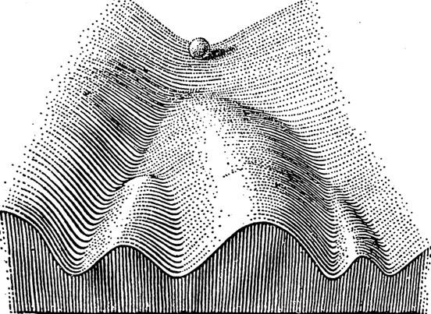
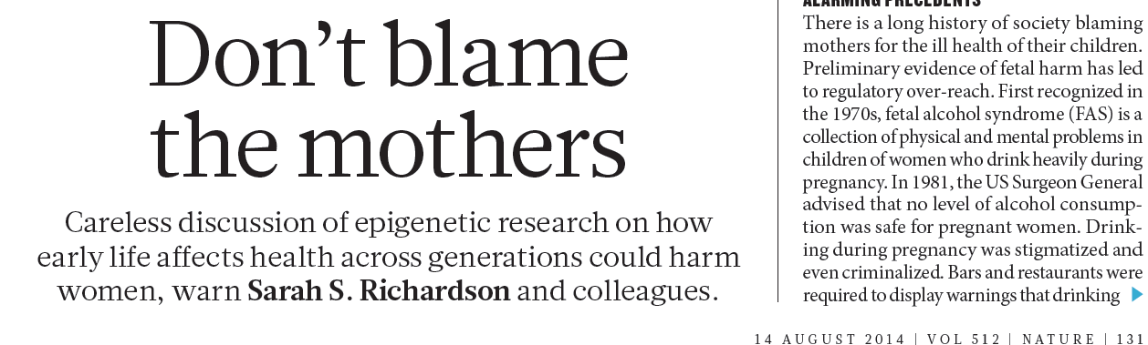
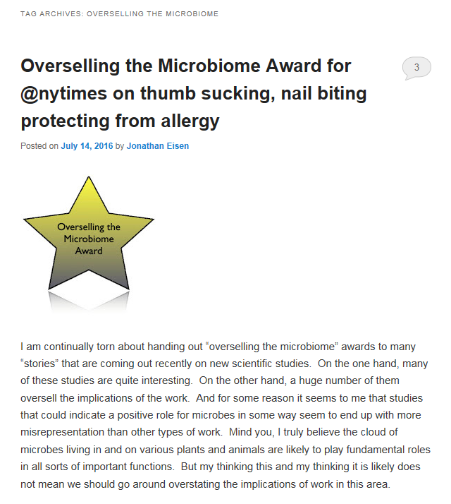
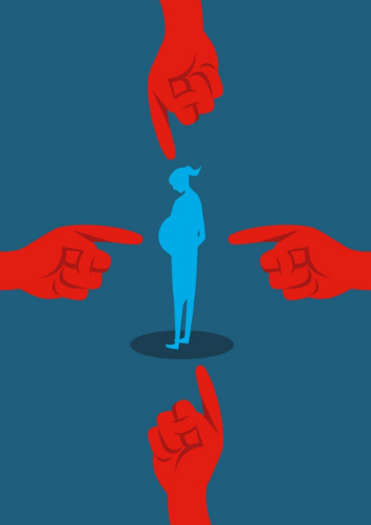
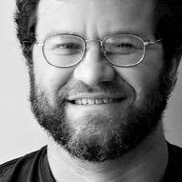
Risks of sweeping claims

