Slide 1
Klokkijken in het Hart
Linda W. van Laake
Hoogleraar en Cardioloog Advanced Hartfalen
University Medical Center Utrecht

Slide 2
Na deze lezing weet u meer over…
De circadiane klok in wortels, muizen en mensen
Relatie klok en hartziekten
Hartfalen
Cardiotoxiciteit van chemotherapie
Stamcellen en hartplakjes
Hybride Engels-Nederlands en per ongeluk wat jargon?

Slide 3
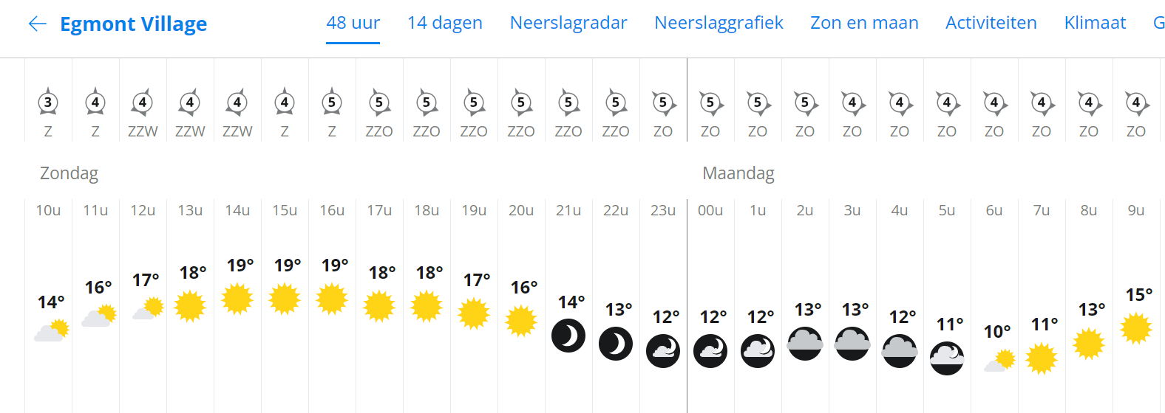
Het weer in Egmond/t

Slide 4
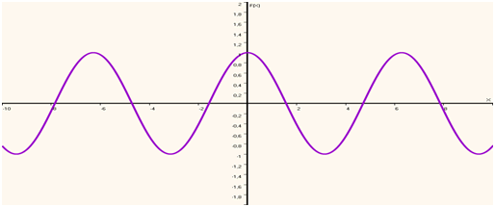
Cosinor Curve

Slide 5
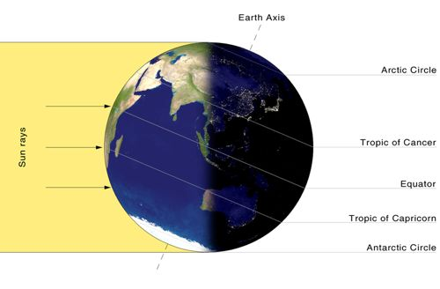
A Role for the Clock? The Big Picture
24 hours
http://polartrek.com
Flat Earth Society

Slide 6
Dag-nacht ritmes in planten
Jean-Jacques d'Ortous de Mairan (1678–1771)
http://plantcellbiology.masters.grkraj.org

Slide 7
Circadiane ritmes in planten: ook zonder externe input!
Jean-Jacques d'Ortous de Mairan (1678–1771)
http://plantcellbiology.masters.grkraj.org

Slide 8
Leven op aarde heeft zich ontwikkeld naar 24-uurs rotatie
Atamian et al (2016): Science 353: 587-590

Slide 9
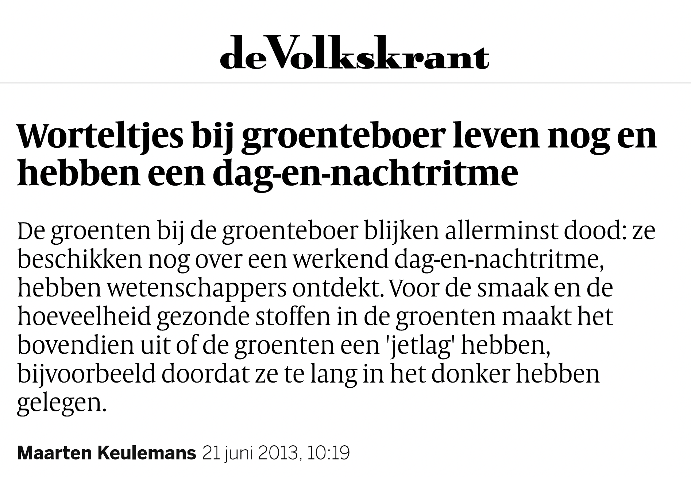
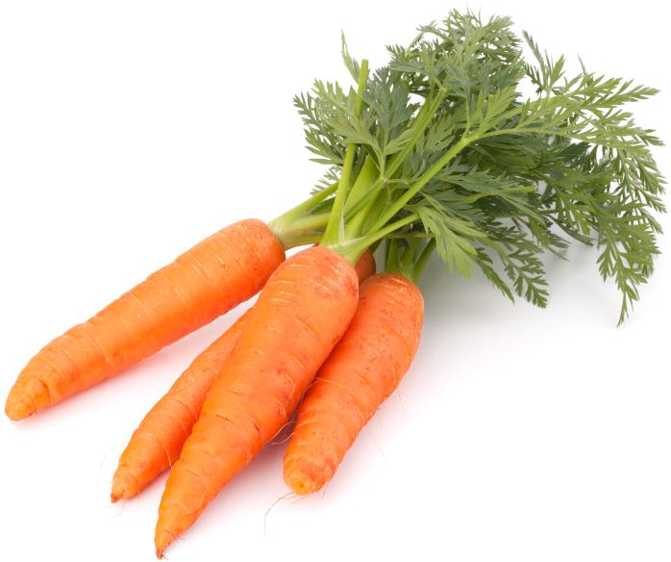
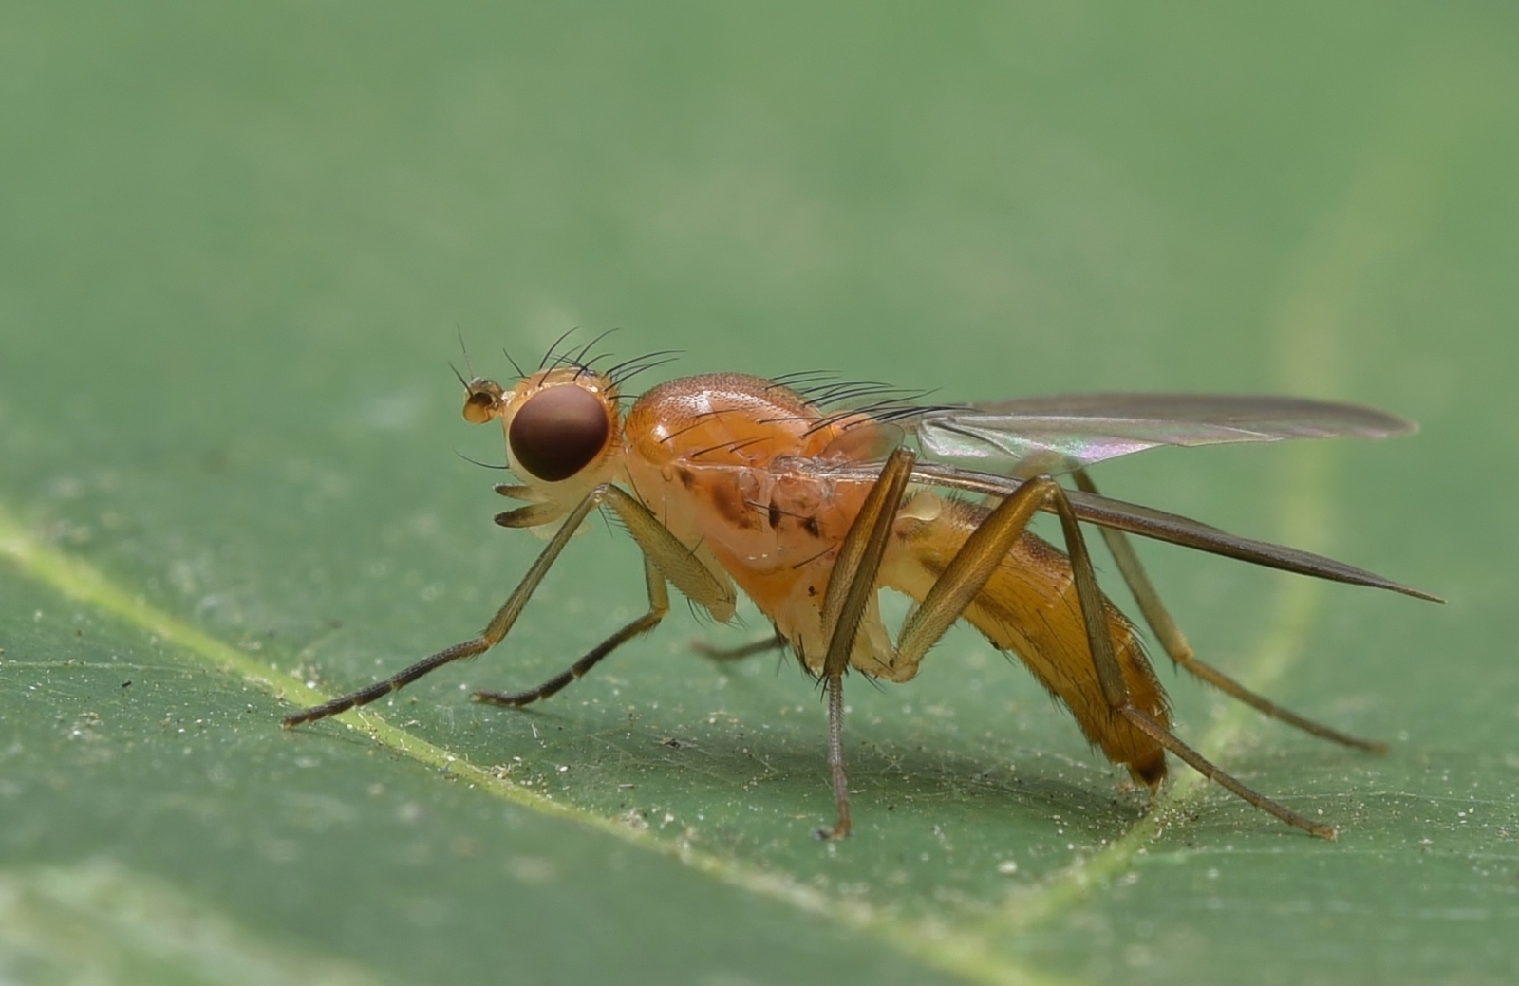
Circadiane ritmes zijn sterk geconserveerd
Goodspeed et al., Current Biology 2013

Slide 10
Circadiane ritmes in regeneratie
Zebrafish fin amputation
Idda et al, PLoS ONE 2012

Slide 11
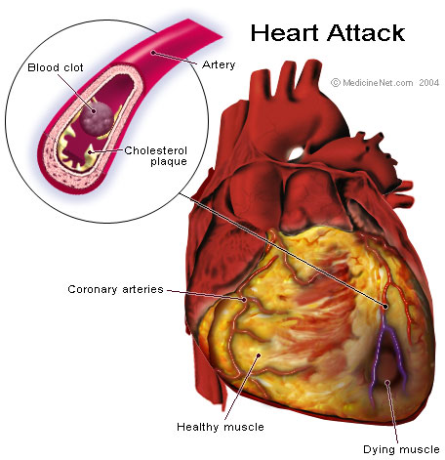
Incidentie van (patho)fysiologie
12 Midnight
11
1
10
2
Infarct-induced heart failure
3
9
Blood pressure, heart rate (2nd peak)
8
4
Heart failure
mortality (2nd peak)
7
5
6
6
5
7
4
8
Infarct and stroke
3
9
Blood pressure, heart rate
2
10
Arrhythmias and sudden cardiac death
1
12
Noon
11

Slide 12
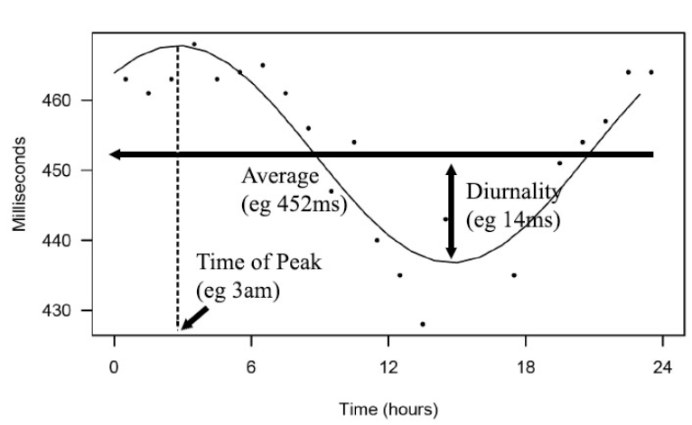
Circadiane ritmes in repolarisatie
Du Pre et al, Frontiers in Physiology 2017

Slide 13
Myocardial Damage is Time-Dependent
↑ Infarct size
Wild-type
→ Time of day of MI
D.J. Durgan et al. Circ Res. 2010

Slide 14
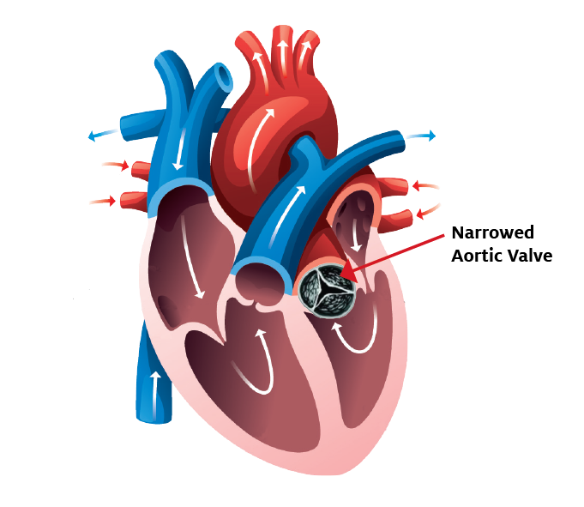
Myocardial Damage is Time-Dependent
Aortic valve replacement
Montaigne et al, Lancet 2018

Slide 15
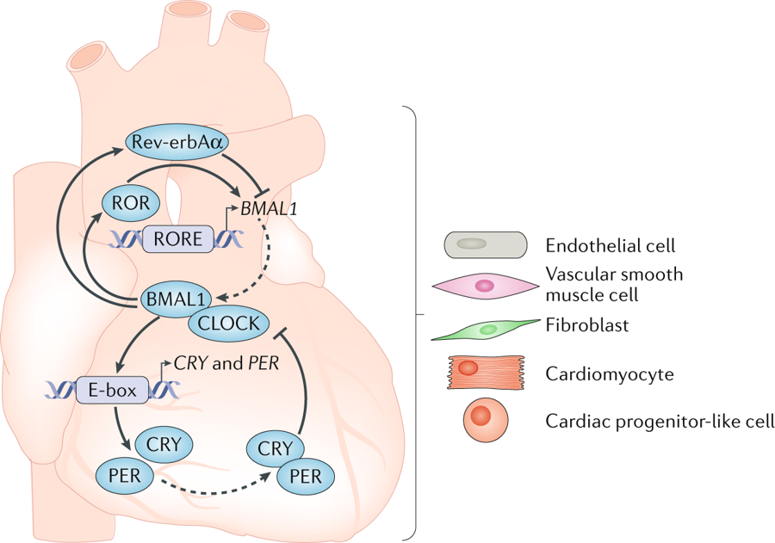
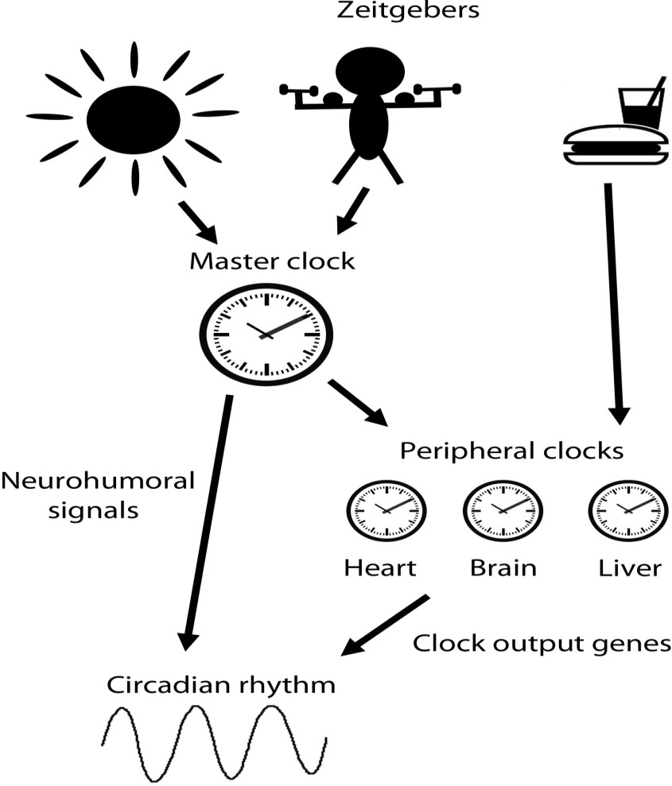
Mechanism Circadian Clock
Du Pre et al, Physiology 2014; Crnko et al, Nature Rev Car 2019

Slide 16
Myocardial Damage is Time-Dependent
↑ Infarct size
Wild-type
→ Time of day of MI
D.J. Durgan et al. Circ Res. 2010

Slide 17
Intacte circadiane klok in de cardiomyocyt
∼10%
E
R
Clock Controlled Genes
P
Kinases
PER
CRY
PER
CRY
-
Per, Cry
Cytosol
CLOCK
BMAL
Nucleus
Bray et al, Am J Physiol Heart Circ Physiol 2008

Slide 18
Gemuteerde circadiane klok in de cardiomyocyt
∼10%
E
R
Clock Controlled Genes
P
Kinases
PER
CRY
PER
CRY
-
X
Per, Cry
Cytosol
CLOCK
BMAL
Nucleus
Bray et al, Am J Physiol Heart Circ Physiol 2008

Slide 19
Myocardial Damage is Cardiomyocyte Clock Dependent
↑ Infarct size
Wild-type
X
Clock
CM-Clock Mutant
→ Time of day of MI
D.J. Durgan et al. Circ Res. 2010

Slide 20
Is the Circadian Clock Relevant in Heart Failure?
Metabolism (e.g. triglyceride and glucose)
Beta-adrenergic signaling (e.g. heart rate)
Ischemia-reperfusion tolerance (Rcan1, regulator of calcineurin; Per2 -> metabolic switch, pGSK3β -> mitochondria)
Hypertrophy (PI3K-AKT-GSK3β)
Arrhythmias (Klf15 → KChIP2 → Ito → QT time)
Bray et al, Am J Physiol Heart Circ Physiol 2008, Rotter, 2013, Jeyaraj et al, Nature 2012

Slide 21
Circadian Variation of Immune Response to acute MI
Kilgallen et al. Front. Pharmacol. 2022

Slide 22
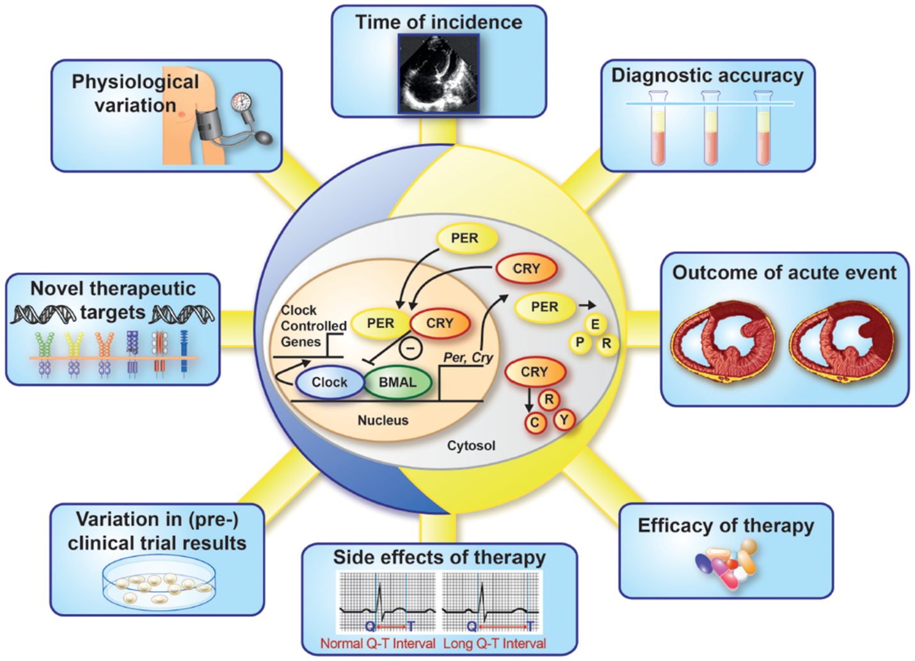
Timing Matters in Cardiovascular Disease!
Van Laake et al, European Heart Journal 2018

Slide 23
Circadian Rhythms in Heart and Repair
Circadian rhythms are important for cardiac health and disease
Circadian rhythms play a role in regeneration/repair
Link between ‘clock’ gene and global gene expression and function in adult cardiomyocytes in the normal heart
Is there a clock in non-adult cardiomyocytes and in the failing heart?

Slide 24
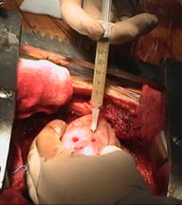
Stamceltherapie voor regeneratie: relevantie van ritmes?
?
?
DuPre et al, Physiology 2014

Slide 25
Definition heart failure
A complex clinical syndrome that can result from any structural or functional cardiac disorder that impairs the ability of the ventricle to fill with or eject blood and identified by a characteristic pattern of hemodynamic, renal, neural and hormonal responses.

Slide 26
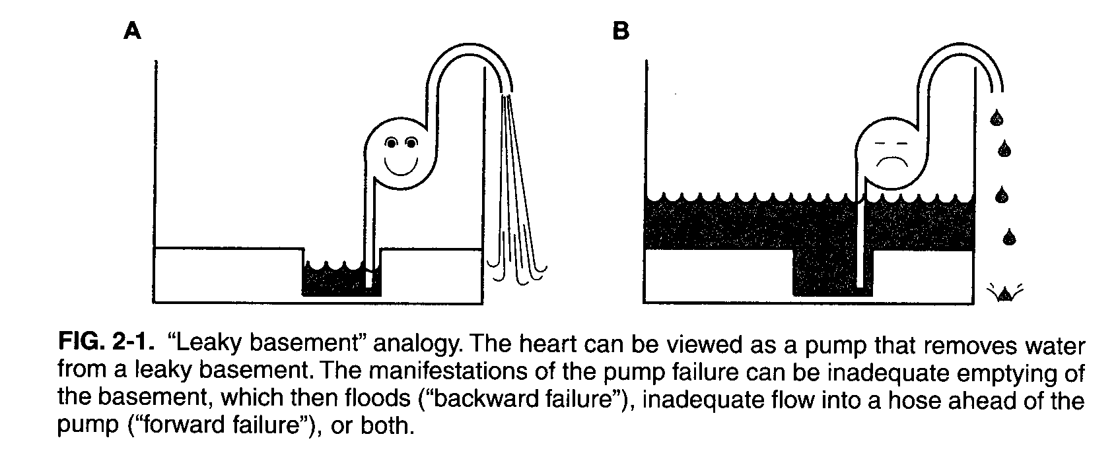
Pathophysiology: the pump

Slide 27
Kliniek – klachten en symptomen
Linkszijdig
Rechtszijdig
backward
forward
backward
longstuwing
lage output
veneuze stuwing
dyspneu
moe,dorst
oedeem
orthopneu
spierzwakte
slechte eetlust
crepitaties
duizeligheid
(lage RR)
verhoogde CVD
orgaan disfunctie
(lever, nier)
cachexie
hepatomegalie
oedeem/ascites

Slide 28
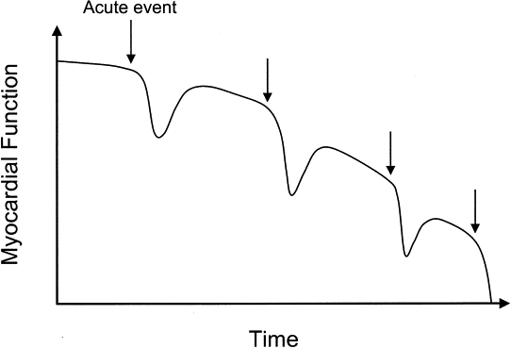
Kliniek - natuurlijk beloop

Slide 29
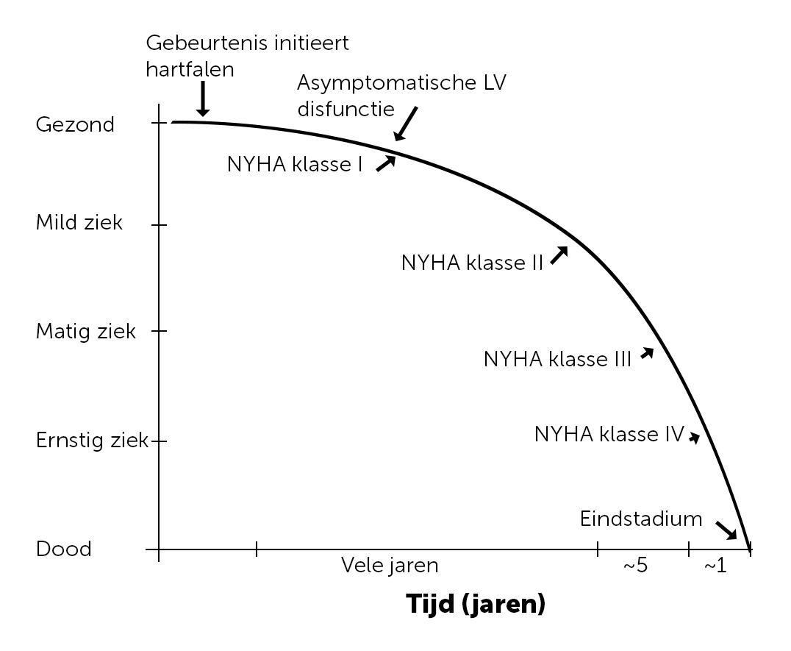
Kliniek - natuurlijk beloop

Slide 30
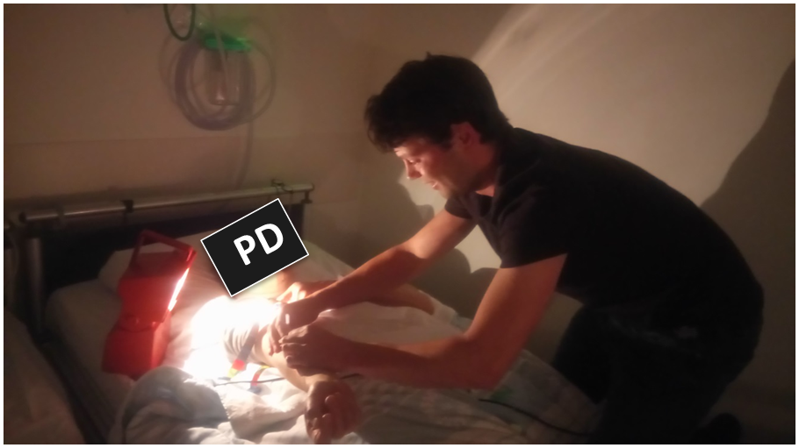
Is the Circadian Clock Relevant in Heart Failure?
Circadian clock highly conserved between species
Studied mostly in healthy subjects or with less severe disease
Clinical study
46 HF patients (72% male, median 60 years, NYHA class II (33%) or III (67%), ischemic cardiomyopathy 44%, diabetes 22%, atrial fibrillation 30%
24 matched controls
7 blood samples in 24 hour
24 hour blood pressure, Holter
Activity watch, sleep/chrono questionnaires
Translational HF models
Mouse (nocturnal)
Zebrafish (diurnal)

Slide 31
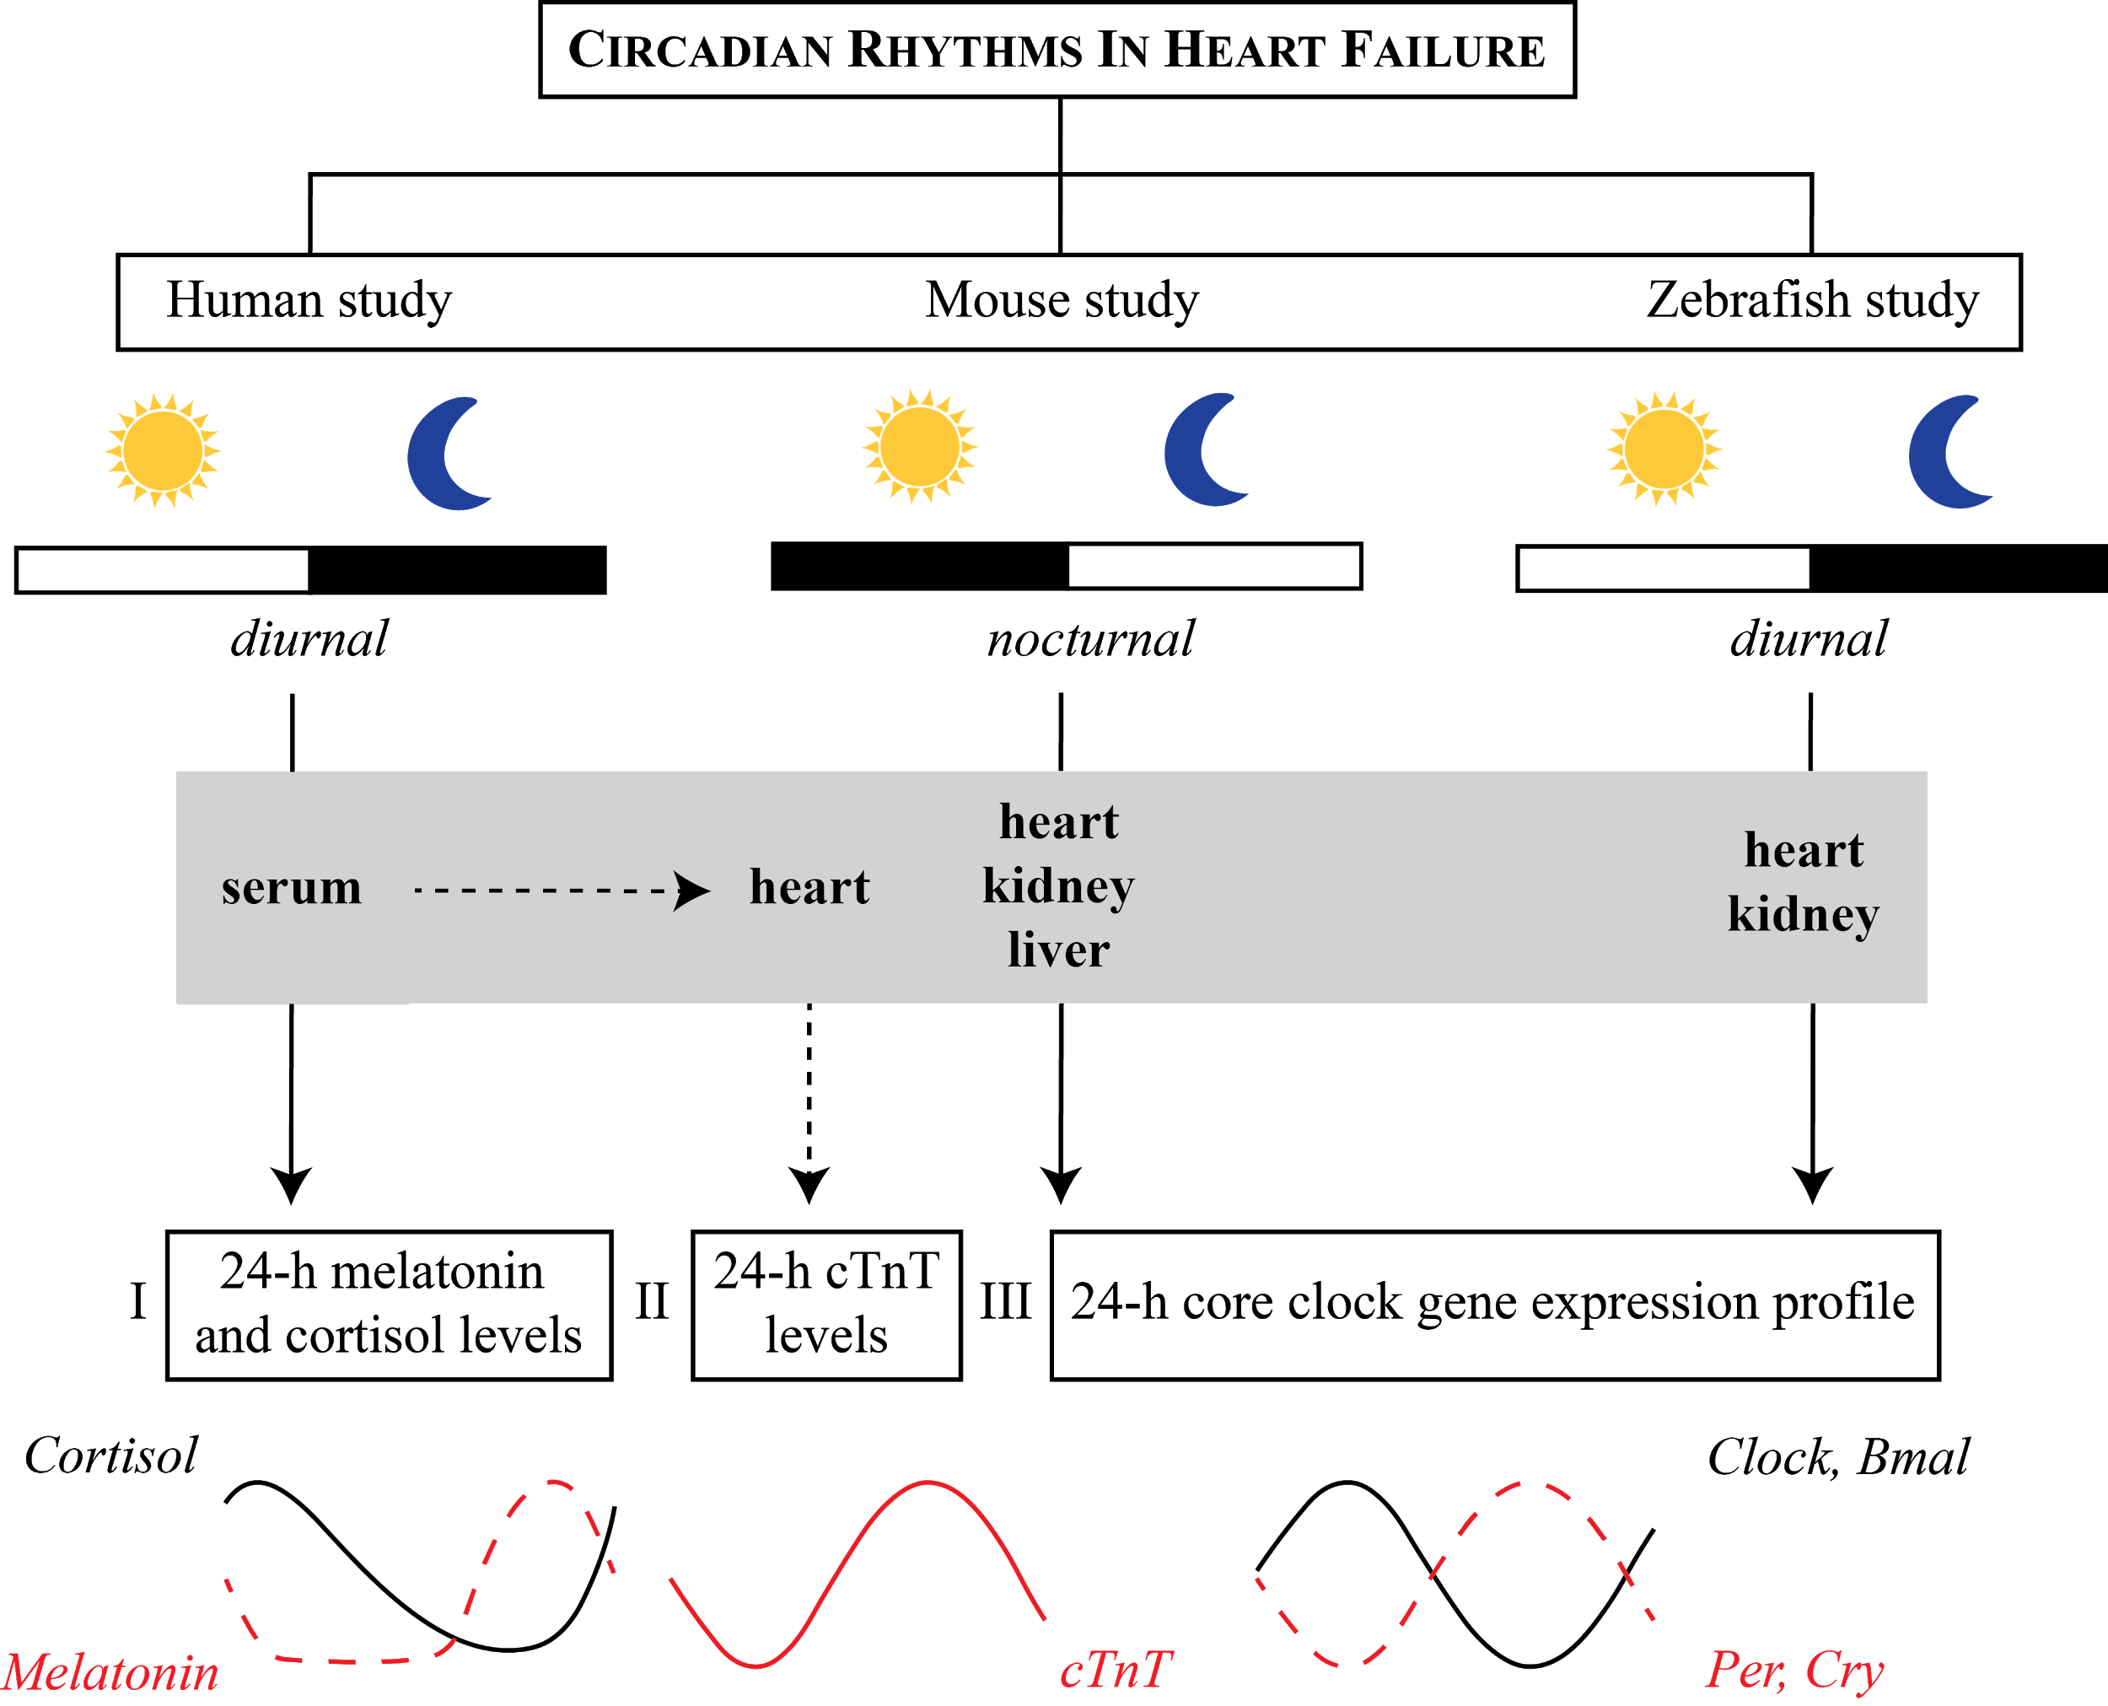
Is the Circadian Clock Relevant in Heart Failure?
Crnko et al. EBioMedicine 2023

Slide 32
The Clock Remains Intact, but with Dampened Hormonal Output in HF
Crnko et al. EBioMedicine 2023

Slide 33
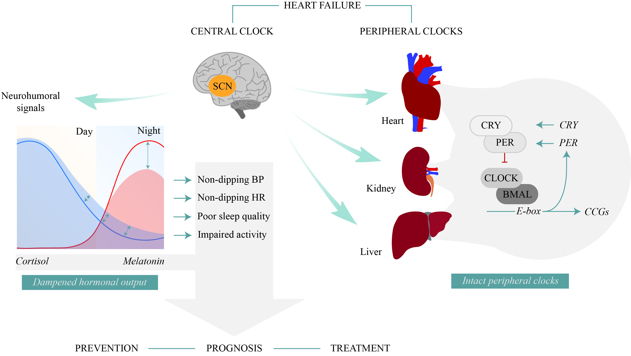
The Clock Remains Intact, but with Dampened Hormonal Output in HF
Crnko et al. EBioMedicine 2023

Slide 34
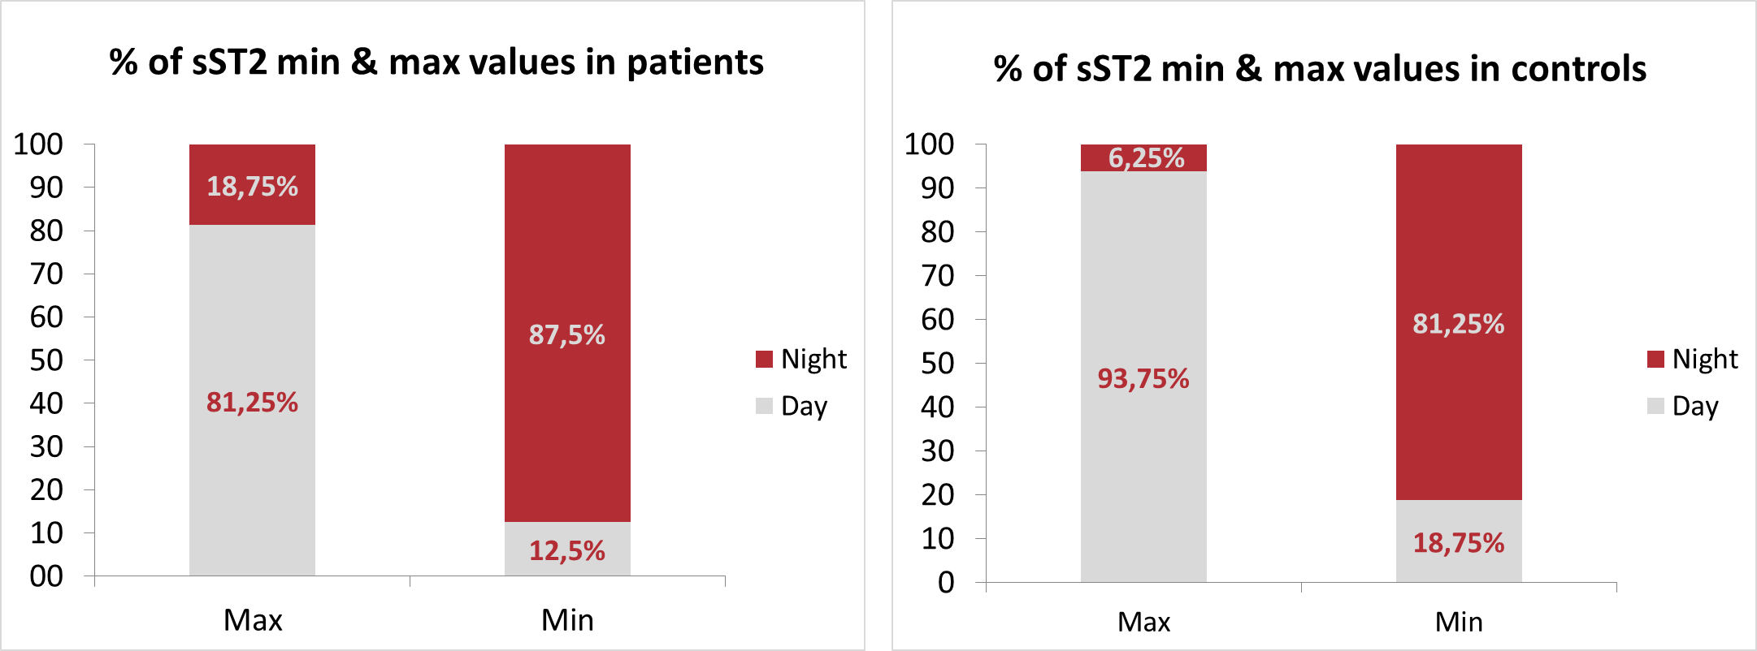
Heart Failure Biomarker sST2 Displays Circadian Rhythm
Prognostic value may increase with constant sampling time; up to 34% difference
Crnko et al, ESC Heart Failure 2020

Slide 35
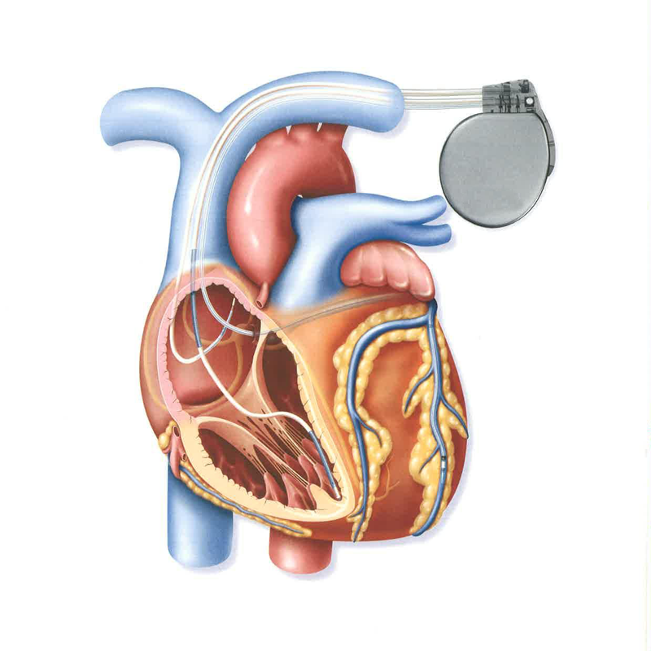
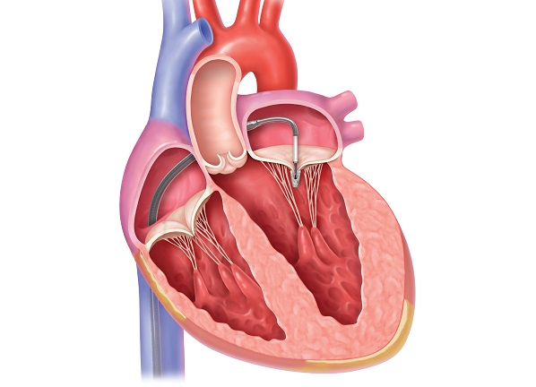
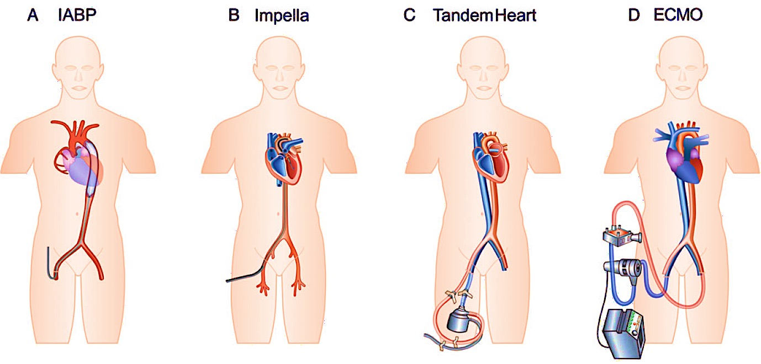
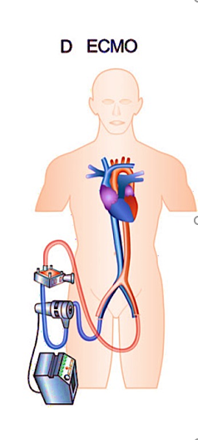
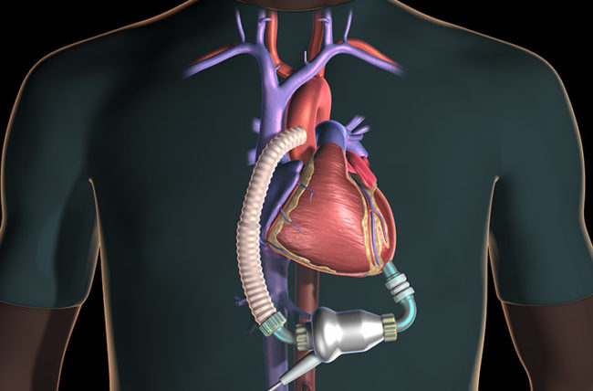
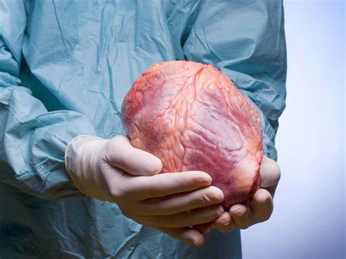
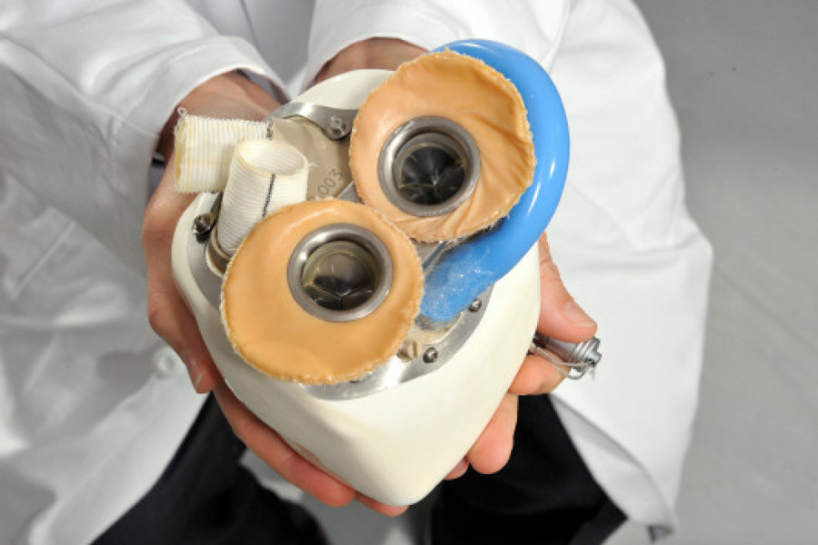
Treatment at the UMCU
Medicatie
ICD / CRT
Klep interventies
Short-term MCS
LV Assist Device
Harttransplantatie
Total artificial heart

Slide 36
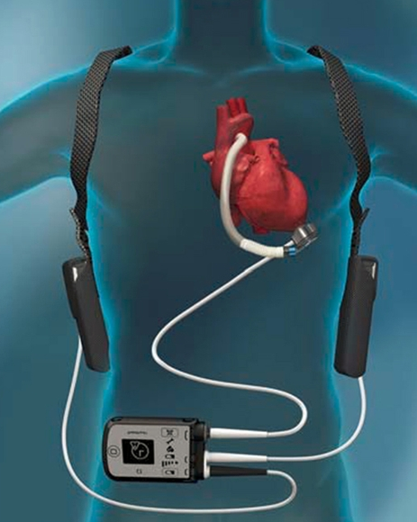
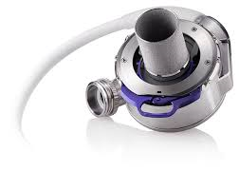
LVAD Evolution

Slide 37
LVAD Pump Parameters Display Circadian Rhythm
Circadian rhythm in power consumption, calculated flow & pulsatility
Fixed speed (RPM)
Loss of circadian rhythm
Clinical manifestation of pump trombosis
Increased power
11 days
Consolo et al, JHLT 2019; Numan et al, Artificial Organs 2023

Slide 38
Stamceltherapie voor regeneratie: relevantie van ritmes?
?
DuPre et al, Physiology 2014

Slide 39
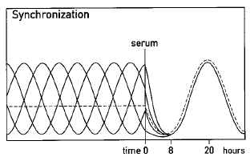
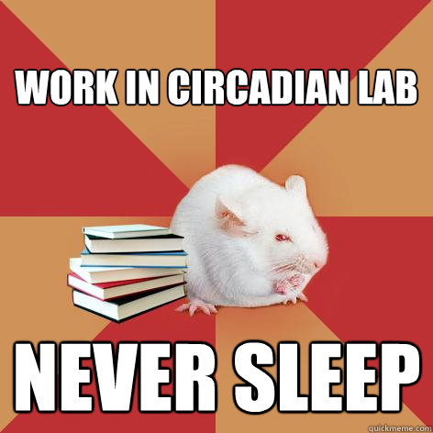
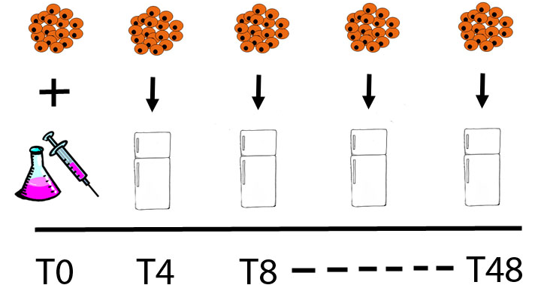
Circadian Rhythms in Human CMs in Vitro ?
Synchronization of circadian phase
Balsalobre et al, Cell 1998
Consecutive sampling
Per2 and Bmal Luc reporters

Slide 40
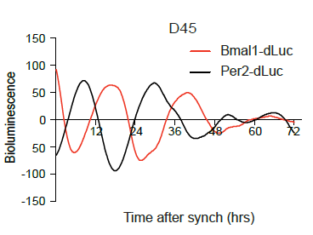
Human Pluripotent Stem Cell-Cardiomyocytes Clock
D0
hPSC-CM develop clock oscillation during differentiation
From day 30, robust clock present
Dierickx et al. EMBO Reports 2017

Slide 41
Stamceltherapie voor regeneratie: relevantie van ritmes!
DuPre et al, Physiology 2014

Slide 42
Timing Matters in Heart Failure and Prevention?
Van Laake et al, European Heart Journal 2018
Chemotherapy toxicity?

Slide 43
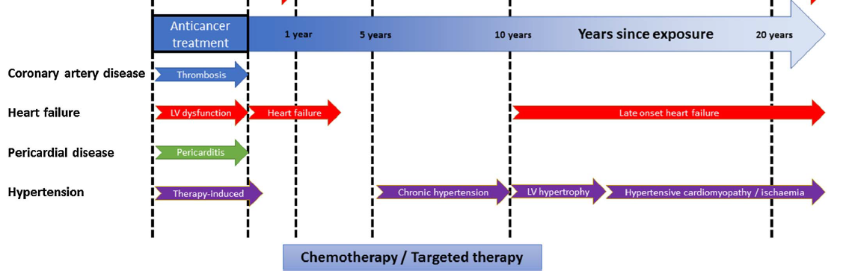
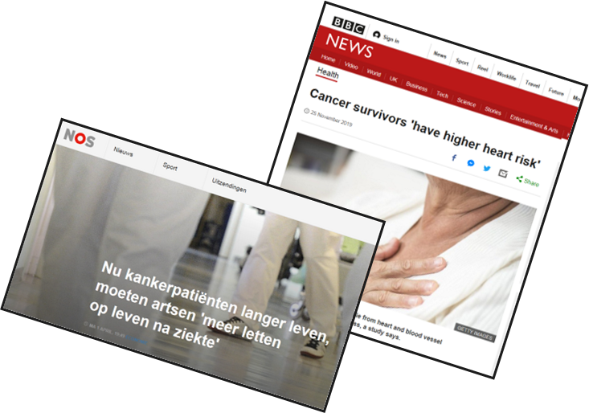
Cardiotoxicity of Chemotherapy
LV dysfunction
HF
Late Onset Heart Failure (HF)
decrease LVEF in 9-24% (cardio-oncology clinic 30%)
> 6% clinical heart failure
Anthracyclins high risk, often used (breast cancer)
Naaktgeboren et al. Maturitas 2017

Slide 44
Prevention of Cardiotoxicity via Circadian Clock
Timing administration
Delayed release system
Clock reset (light, exercise, food)
Pharmacological clock reset
Novel pharmacological targets

Slide 45
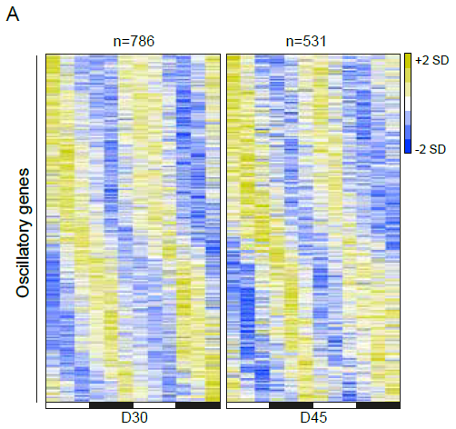
Clock-Controlled Genes in Human Stem Cell-Derived Cardiomyocytes
Clock output pathways (RNAseq)
786 genes at D30 2D
1052 genes 3D
Dierickx et al. EMBO Reports 2017

Slide 46
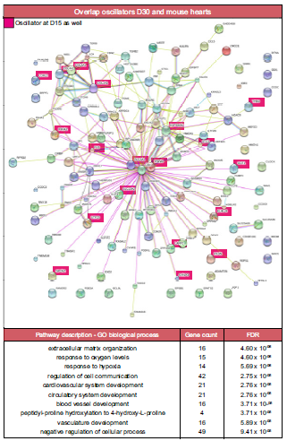
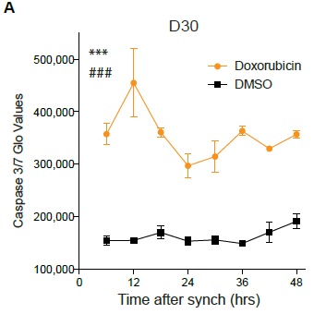
hPSC-CM Clock Output and Chemotherapy
Clock controlled genes include a stress-response network
Doxorubicin-induced cell death is dependent on circadian time
Dierickx et al. EMBO Reports 2017

Slide 47
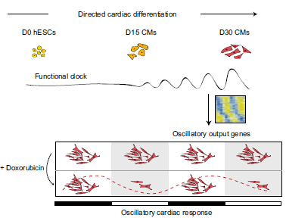
Circadian Clock in hPSC-derived Cardiomyocytes
Time-Dependent Cardiotoxicity
Dierickx et al. EMBO Reports 2017

Slide 48
Time-Dependent Toxicity Can Be Modified
SIRT1 = NAD-dependent deacetylase
Cardiovascular field:
Cardiac growth & stress
Stress damage protection
Hypertrophy, aging
Involved in molecular clock
Circadian pattern of expression in neonatal rat cardiomyocytes
Du Pre et al. JMCC 2017

Slide 49
Time-Dependent Toxicity Can Be Modified
Protection enhanced
SIRT1 stimulation reduces circadian variation in stress tolerance
Du Pre et al. JMCC 2017

Slide 50
Time-Dependent Toxicity Can Be Modified
Protection abolished
SIRT1 inhibition reduces circadian variation in stress tolerance
Du Pre et al. JMCC 2017

Slide 51
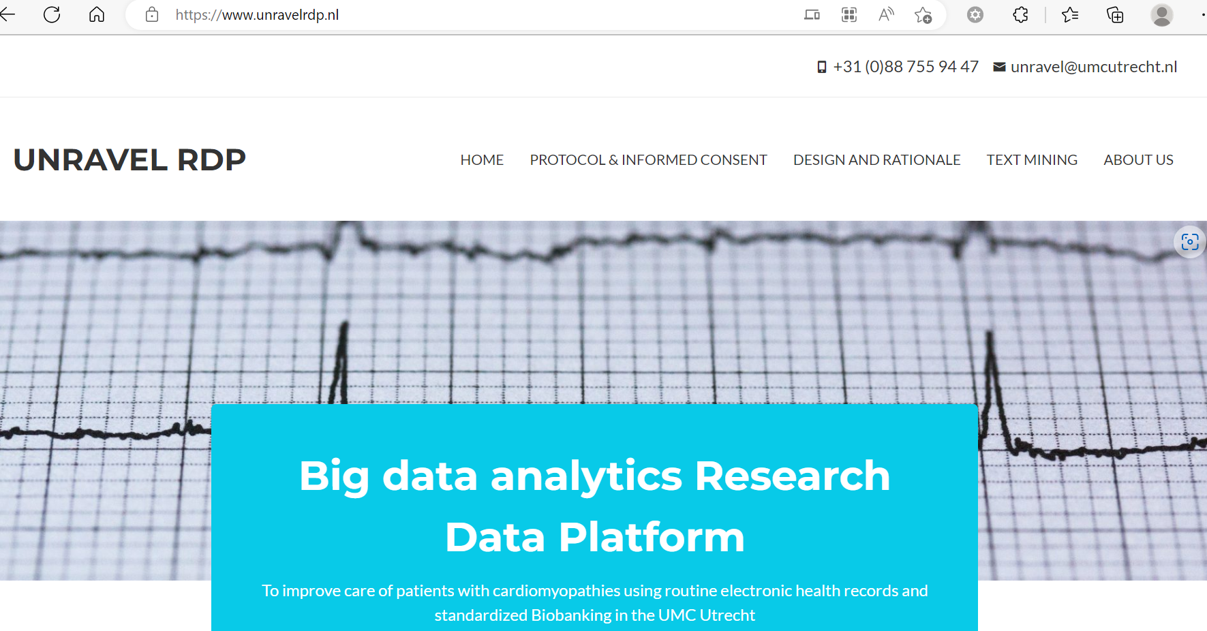
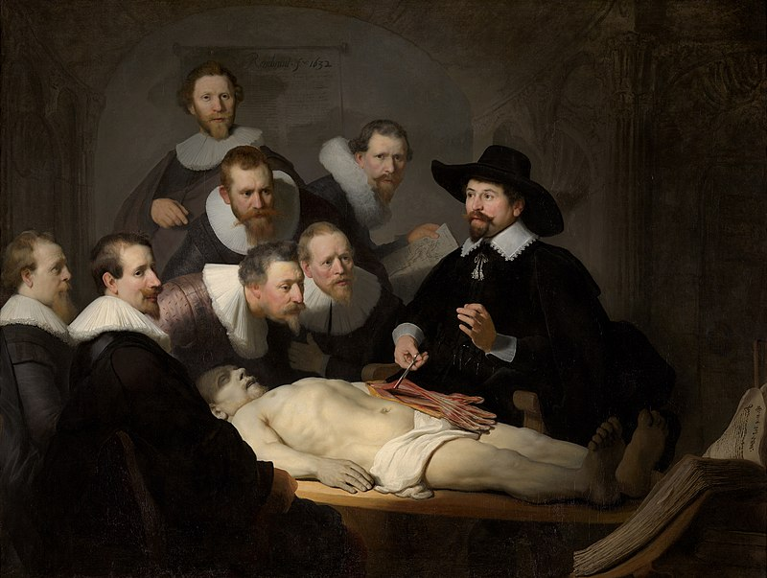
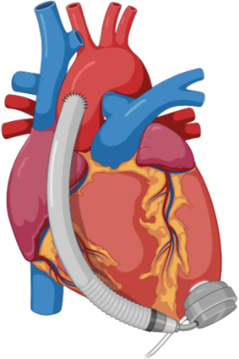
Human Models of Cardiotoxicity
Sources of myocardial tissue
Heart transplant
LVAD implantation
Fresh post-mortem / rejected donor hearts
Preparation of live myocardial slices
2x2 cm
0.03 mm/s
300 μm thick
Adapted from: Fischer C et al. Nature Communications (2019) & InvitroSys

Slide 52
The Most Complex “Model” of Chronotherapy: the Patient

Slide 53
Chronomodulated Chemotherapy Appears Safe
No good data on cardiotoxicity
Printezi et al. Lancet Oncology 2022

Slide 54
Prevention of Cardiotoxicity via Circadian Clock
Timing administration
Delayed release system
Clock reset (light, exercise, food)
Pharmacological clock reset
Novel pharmacological targets

Slide 55
Conclusies
Circadiane klok beinvloedt de mate van hartschade
Circadiane klok blijft (gedempt) functioneel bij hartfalen
Tijdsafhankelijke hartschade kunnen we modelleren in vitro in humane cellen
Verder onderzoek nodig t.a.v. verband moleculaire klok, regeneratie, en hartfalen om behandeling te verbeteren
Translatie naar kliniek kan chemo-cardiotoxiciteit verminderen?

